Slide 1


ScRNASeqSnap:
Single cell RNA Seq Snap workflow
Antonia (Tonia) Chroni, PhD
Senior Bioinformatics Research Scientist
DNB Bioinformatics Core
December 10, 2024
Notes:
I am an evolutionary computational biologist by training with extensive expertise in WGS/WES, sc-RNA-Seq, sc-ATAC-Seq and sc-TCR/BCR-Seq analysis in the context of tumor evolution, phylogenetics, and microenvironment.
I’m a Senior Bioinformatics Research Scientist at the DNB Bioinformatics Core. I am passionate about bulding and automating computational workflows and pipelines for scientists, and I am here to discuss the automated pipeline I am working on currently for analyzing single cell/nuclei seq named snap ☺

Slide 2







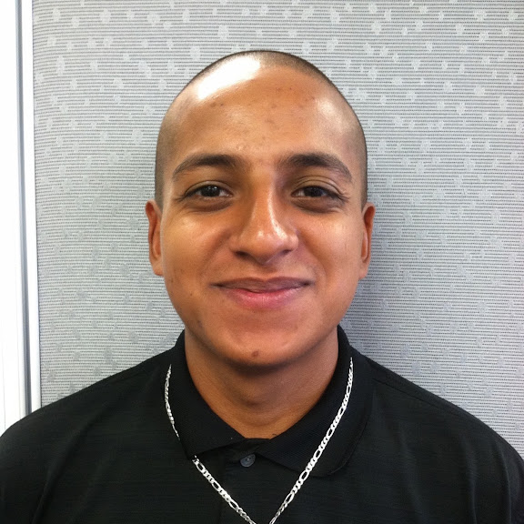
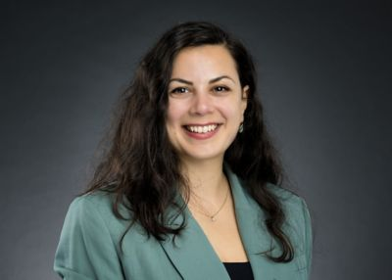
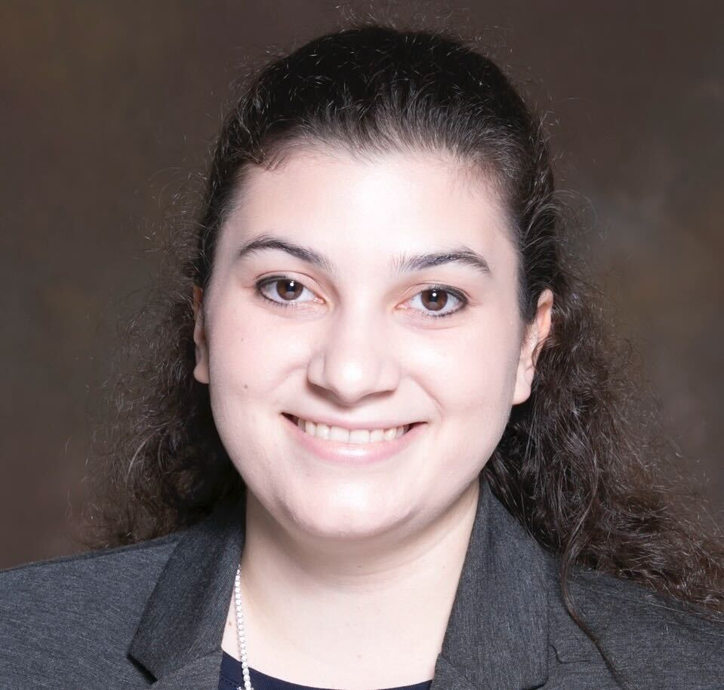
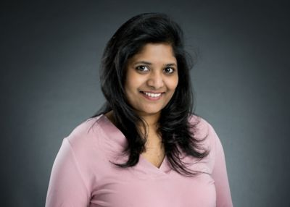
Bioinformatics core, Department of Developmental Neurobiology
Providing advanced bioinformatic services for investigators to leverage omics data
Project analysis & Benchmarking
Consultation
Training
Innovation
Cody Alexander Ramirez, PhD
Senior Bioinformatics Research Scientist
Core Director
Boston, Massachusetts
Antonia Chroni, PhD
Senior Bioinformatics Research Scientist
New York, New York
Sharon Freshour, PhD
Bioinformatics Research Scientist
St. Louis, Missouri
Asha Jacob Jannu, PhD
Bioinformatics Research Scientist
Indianapolis, Indiana
Notes:
We are here to help you decide on what method and tool and data analysis strategy make the most sense for your research questions and to facilitate discussion with the Center for Applied Bioinformatics (CAB) St. Jude Research.
We have more trainings coming up, and we are happy to provide trainings on specific sequencing technology or steps of it that is useful to you and your Lab’s needs.
We encourage you to reach out and ask us questions as this also helps us to think outside of the box, innovate and create tools and modules of analysis that will help us altogether to understand omics data and find cures for these pediatric catastrophic diseases.
Our project analysis and trainings are available at our GitHub account.

Slide 3
Code of Conduct
No child is denied treatment based on race, religion, or a family's ability to pay.
Advance cures and prevention for pediatric catastrophic diseases through research and treatment.
Be respectful and graceful
Gracefully accept constructive criticism.
Focus on what is best for the community.
Welcoming and inclusive
Value and respect everyone’s viewpoints and experiences.
Use welcoming and inclusive language.
Share groundbreaking discoveries and research.
Show courtesy and respect towards other community members.
Be kind
and
have fun
We welcome everyone in the research community.
We are committed to creating a friendly and respectful place for learning, teaching, and contributing.
Notes:
Our vision is that every child diagnosed with cancer or another catastrophic disease has access to quality care and treatment.
Our code of conduct at the core is to do that through the sharing of knowledge, technology and organizational skills. We welcome everyone in the research community into creating a friendly and respectful place for all of us to learn, teach each other and contribute.

Slide 4
Learning Objectives
Overview of Tools and Methods in the `ScRNASeqSnap` workflow
Reviewing Results, Plots, and Reports
Notes:
Without further ado, in today’s agenda includes an Overview of the Tools and used in our snap pipeline, and I will walk you though on the project organization and what to expect in terms of results, plots and reports generated by each module of analysis.

Slide 5

Single cell RNA Seq Snap workflow (ScRNASeqSnap)
🚀 Automated suite of analysis modules for upstream and downstream analyses
🧬 sc/snRNA data analysis from 10X sequencing technology for non-hashed experiments
🎉 Human, mouse, and dual index genome experiments
📝 Thorough and step-by-step documentation on how to use each analysis module
🐳 Reproducible and replicable results via Docker/singularity
Publicly available at stjude-dnb-binfcore/sc-rna-seq-snap
Notes:
We have created the Single cell RNA Seq Snap workflow (ScRNASeqSnap), a dynamic, automated suite of tools and modules for upstream and downstream analyses for analyzing single cell and single nuclei RNA (sc/snRNA) data from 10X sequencing technology.

Slide 6
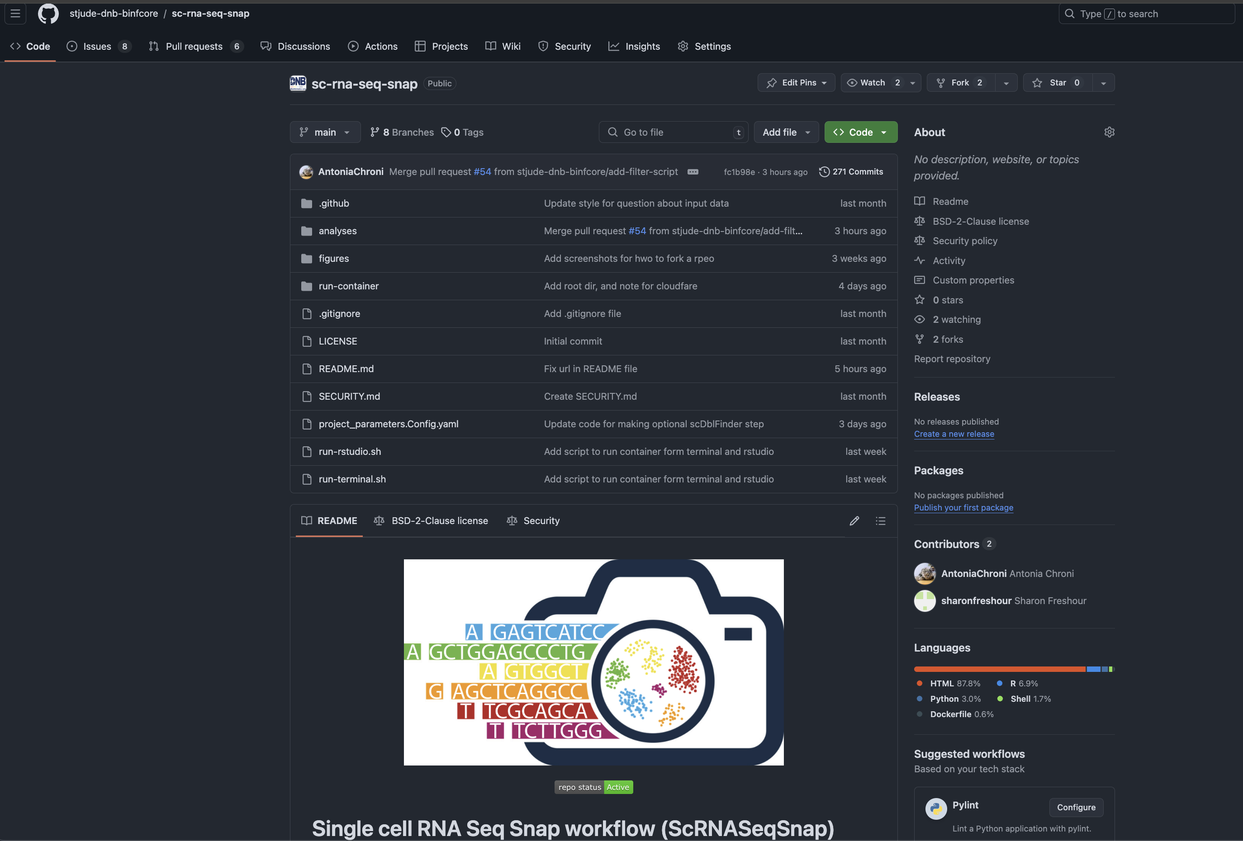
Single cell RNA Seq Snap workflow (ScRNASeqSnap)
https://github.com/stjude-dnb-binfcore/sc-rna-seq-snap
Notes:
if you click on Readme file you will find a thorough documentation about how to use the repo and access the code.

Slide 7
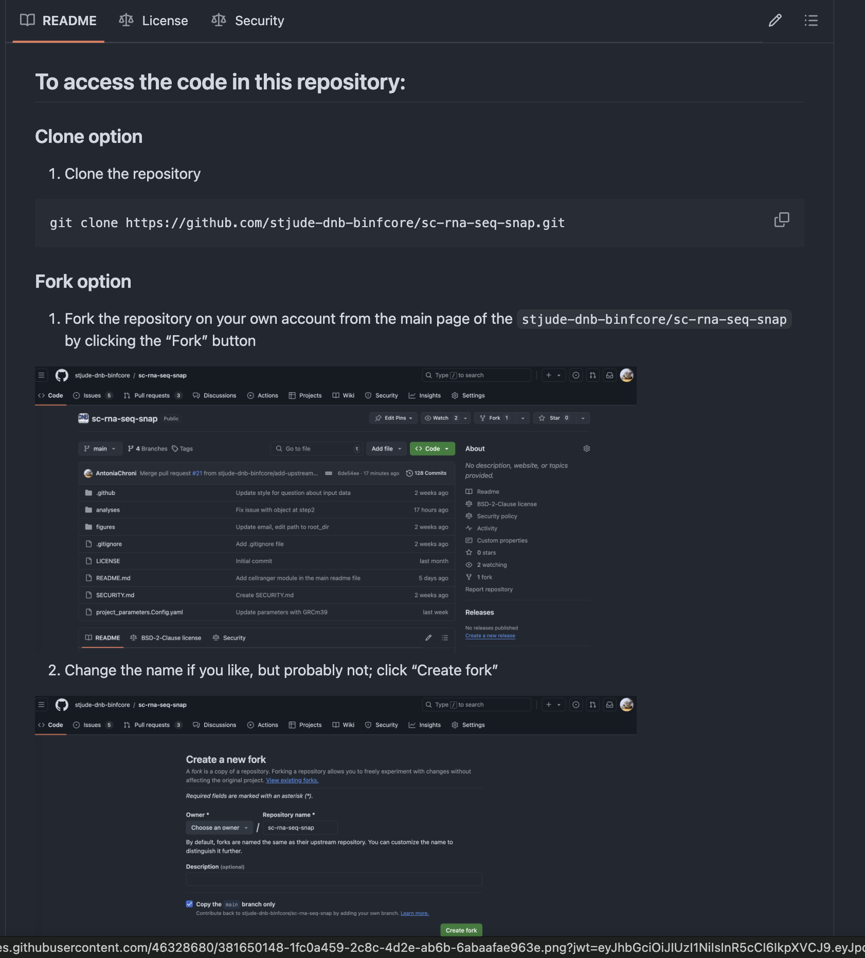
How to access the code
Notes:
There are two options to access the code in the GitHub repository. The first option is to

Slide 8
How to access the code
Notes:
There are two options to access the code in the GitHub repository. The first option is to

Slide 9
How to access the code
Notes:
There are two options to access the code in the GitHub repository. The first option is to

Slide 10
Forking a repository on GitHub
Click the “Fork” button
https://github.com/stjude-dnb-binfcore/sc-rna-seq-snap

Slide 11
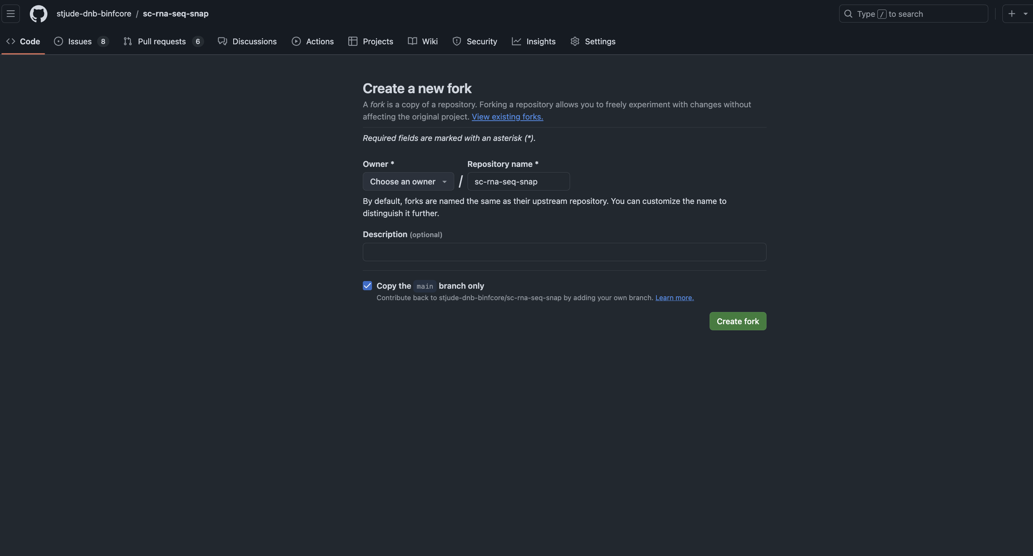
Forking a repository on GitHub
Change the name if you like, but probably not; click “Create fork”
https://github.com/stjude-dnb-binfcore/sc-rna-seq-snap

Slide 12
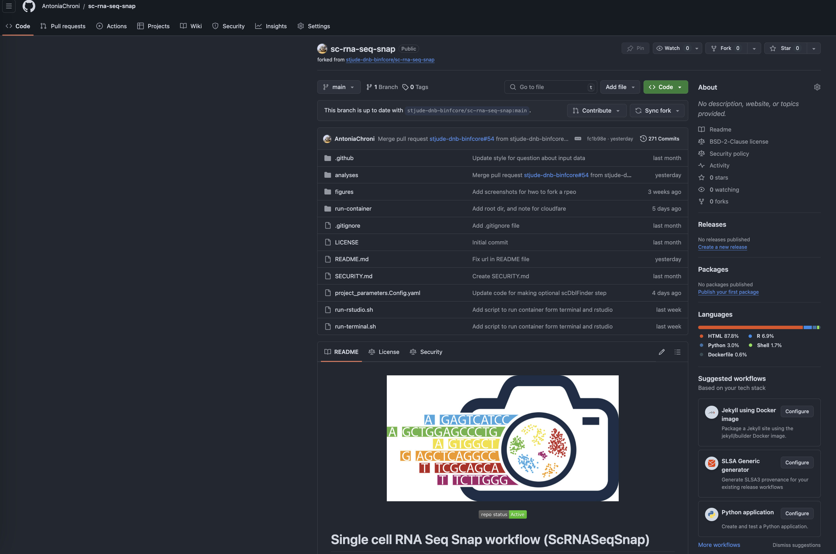
Forking a repository on GitHub
Enjoy your new repo!
https://github.com/stjude-dnb-binfcore/sc-rna-seq-snap

Slide 13
ScRNASeqSnap is automated, reproducible and replicable
https://github.com/stjude-dnb-binfcore/sc-rna-seq-snap

Slide 14


ScRNASeqSnap is automated, reproducible and replicable
Documentation & Usability
Automation
Containers
Slide from the ”Automation and Reproducibility in Computational Biology” course
Notes:
In our team we follow best practices for automated and reproducible pipeline including thorough documentation and code review. we use git version app

Slide 15
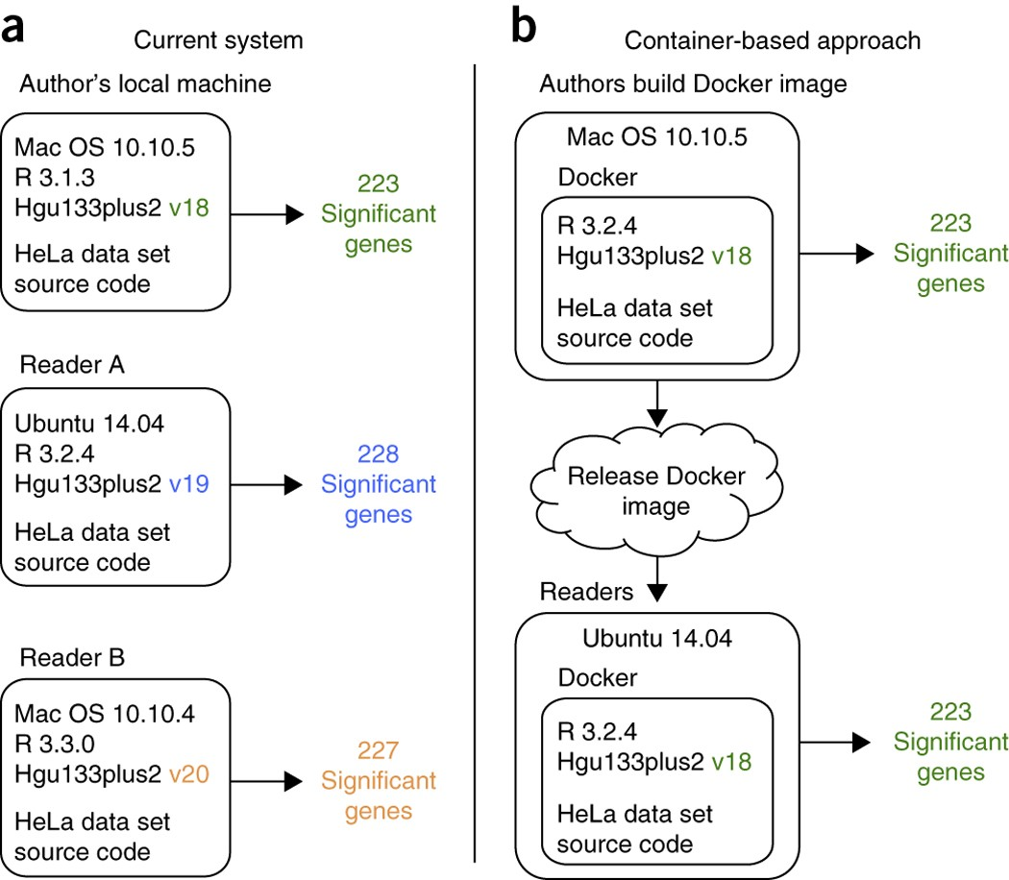
ScRNASeqSnap is automated, reproducible and replicable
Docker and Singularity
“Containers” that include everything from the operating system up
Run one OS inside another, with all the things frozen to particular versions.
Dockerfile/rstudio_r_4.4.0_seurat_4.4.0.def

Slide 16
ScRNASeqSnap is automated, reproducible and replicable
+ lsf script/analysis module
https://github.com/stjude-dnb-binfcore/sc-rna-seq-snap
Notes:
There are three options to run the analysis modules on HPC: either interactively on a node via terminal or web Rstudio, or by submitting an lsf job.

Slide 17
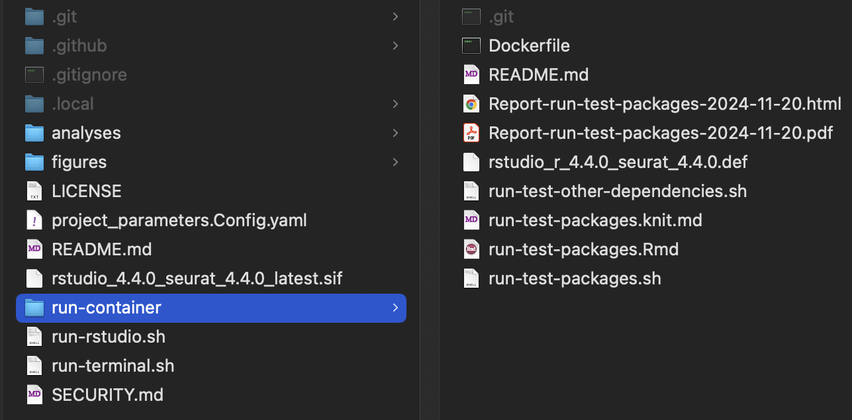
ScRNASeqSnap is automated, reproducible and replicable
Notes:
More information can be found in the `run-container` folder about the packages and dependencies available at the current container version.

Slide 18
Repository organization and project tidiness
Use Folders/Directories
Keep separate projects separated
Separate sections for units within a project
analyses/<module_name>
code
plots
results
reports
data
figures
project_parameters.Config.yaml
…
Documentation throughout: Describe what files do and how they are organized/folder.
Notes:
We maintain a structured and predictable organization system across repositories and projects.

Slide 19
Repository organization and project tidiness
https://github.com/stjude-dnb-binfcore/sc-rna-seq-snap

Slide 20
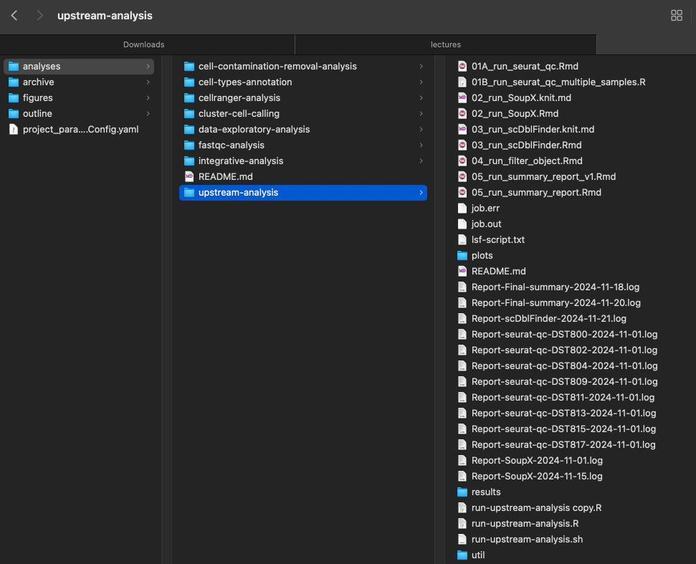
My typical project organization system

Slide 21
Customize your project based on the experiment!
https://github.com/stjude-dnb-binfcore/sc-rna-seq-snap

Slide 22
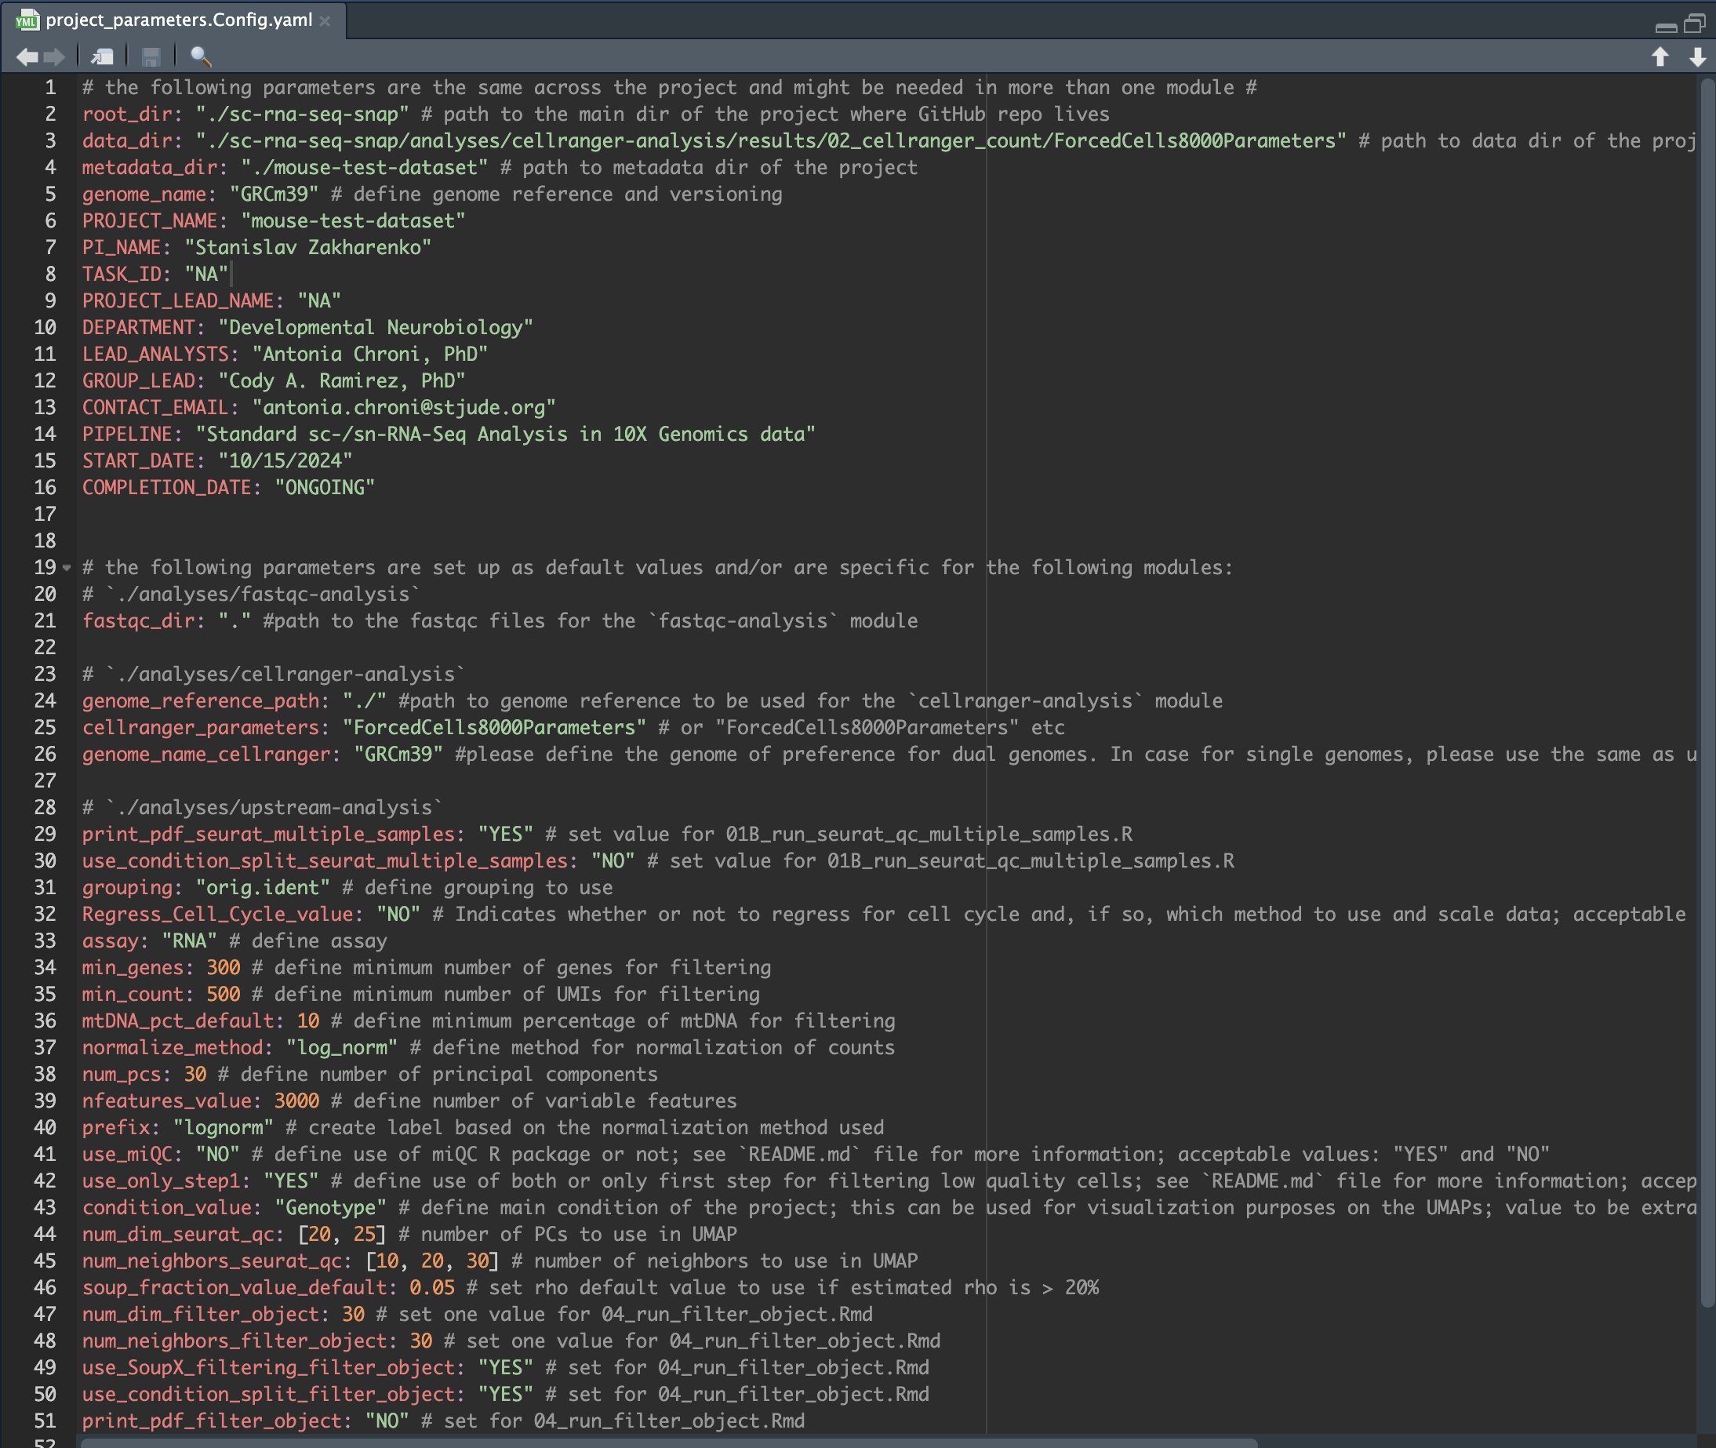
Project parameters file

Slide 23
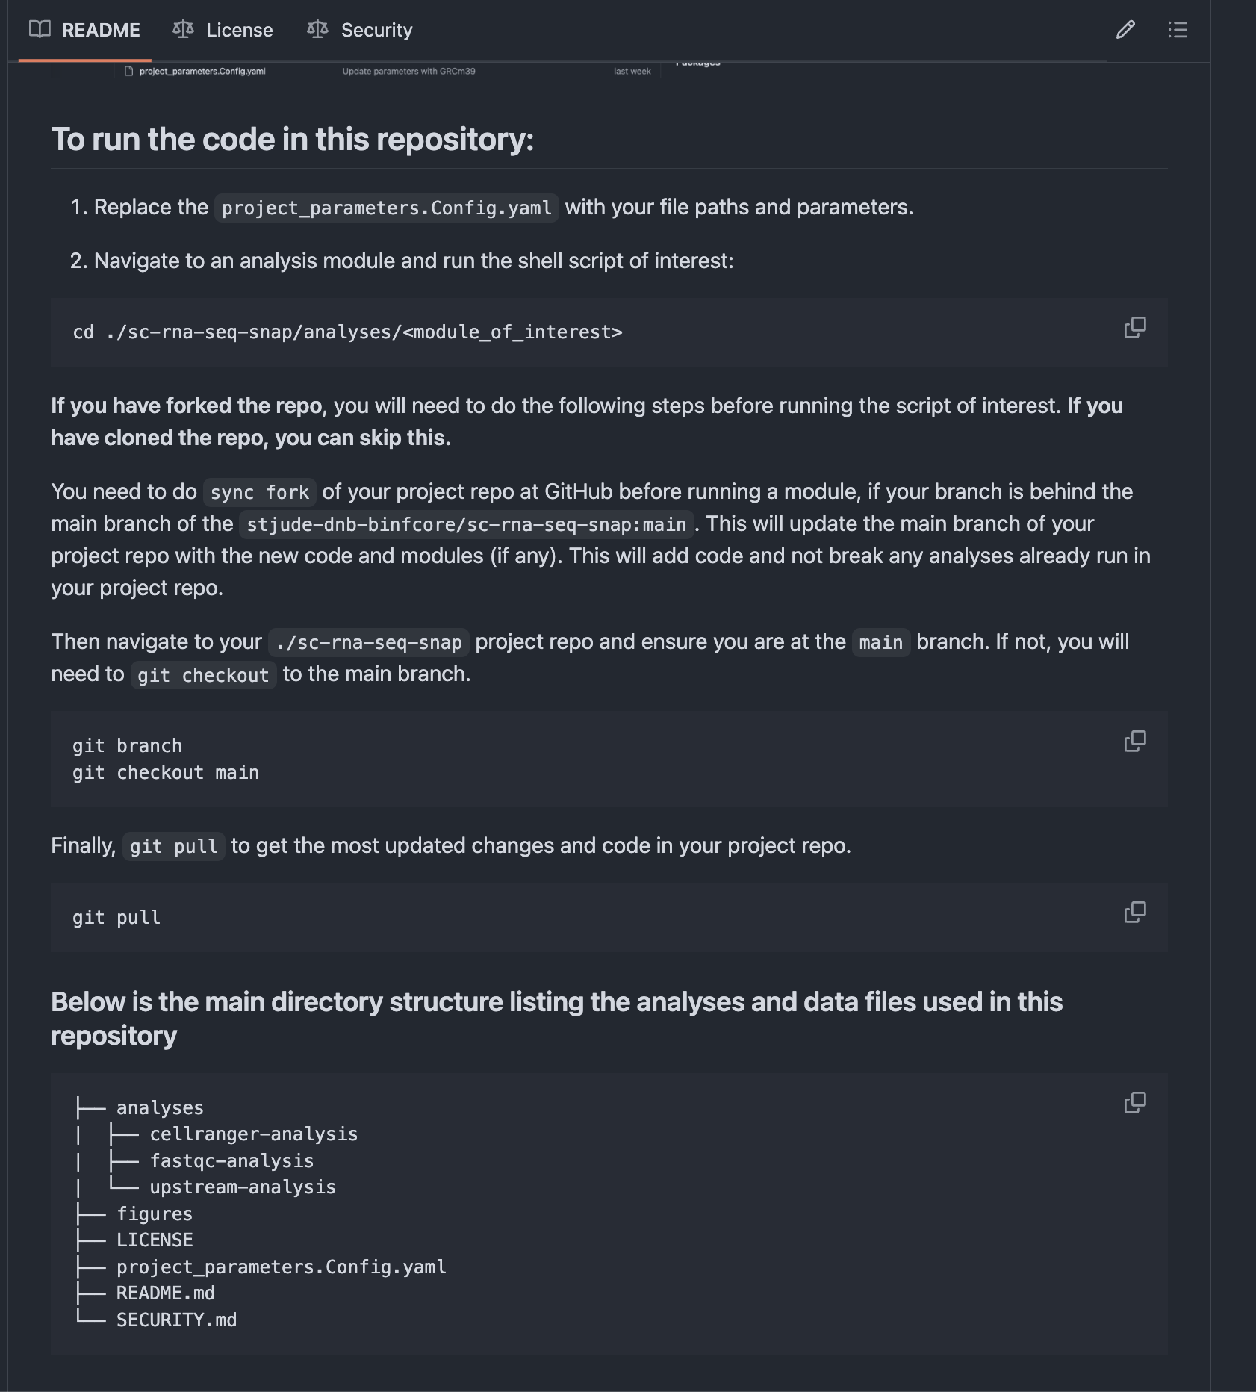
How to run the code

Slide 24
ScRNASeqSnap analysis modules
We recommend the following order in running analysis modules which is up to customization based on the user's needs.
`fastqc-analysis` module (help=`Required`. Pipeline for FastQC quality control tool for high throughput sequence data analysis.)
`cellranger-analysis` module (help=`Required`. Pipeline for running and summarizing Cell Ranger count for single or multiple libraries.)
`upstream-analysis` module (help=`Required`. Pipeline for estimating QC metrics and filtering low quality cells.)
`integrative-analysis` module (help=`Required`. Pipeline for Integrative analysis.)
`cluster-cell-calling` module (help=`Required`. Pipeline for cluster cell calling and gene marker analysis.)
`cell-contamination-removal-analysis` module (help=`Optional`. To remove clusters and repeat steps (4) and (5), e.g. for PDX experiments)
`cell-types-annotation` module (help=`Required`. Pipeline for annotating cell types.)
Upstream
Downstream

Slide 25
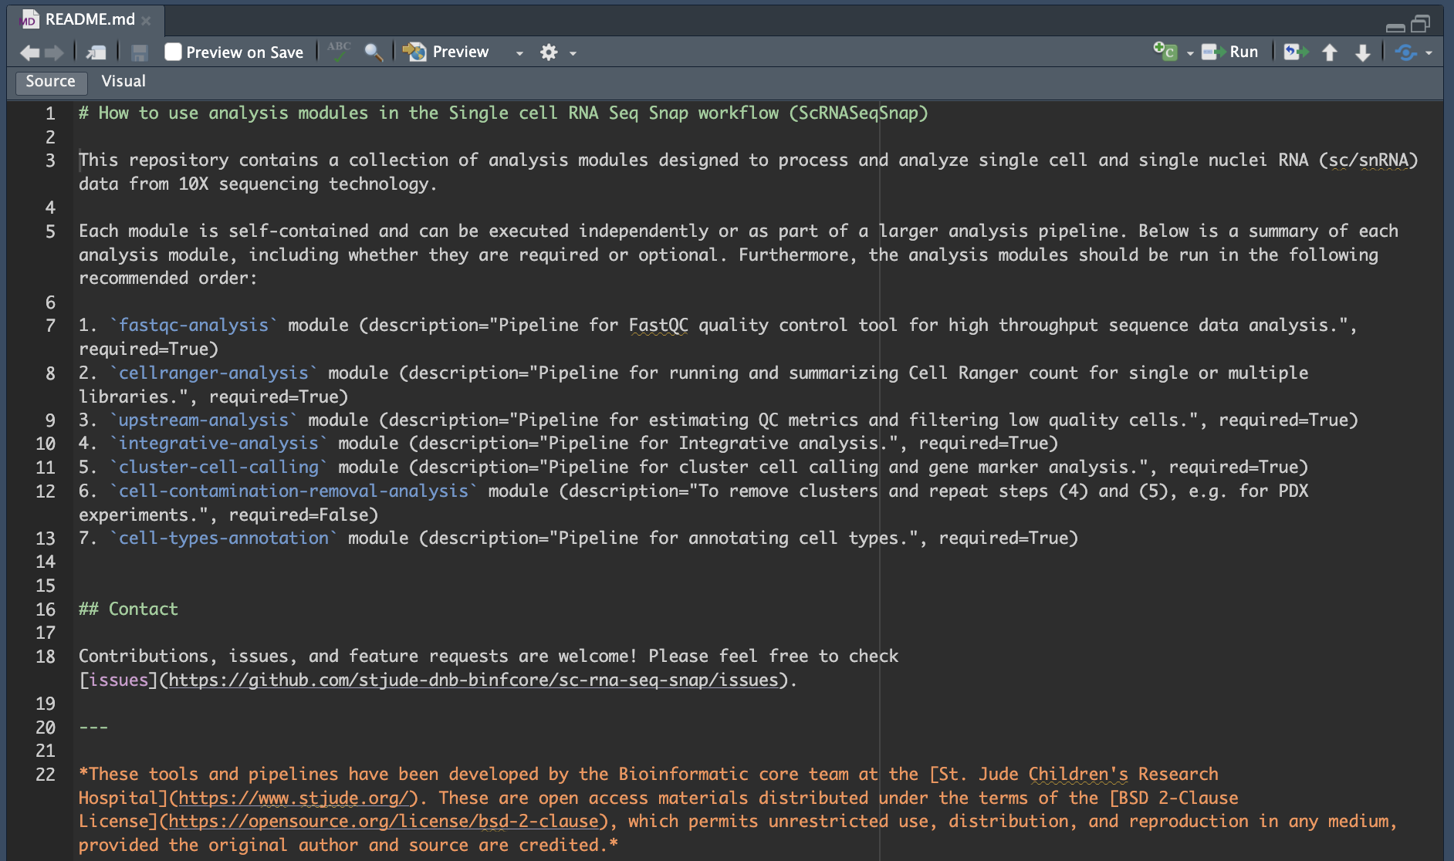
ScRNASeqSnap analysis modules
Upstream
Downstream

Slide 26
ScRNASeqSnap analysis modules
Upstream

Slide 27
ScRNASeqSnap analysis modules
We recommend the following order in running analysis modules which is up to customization based on the user's needs.
`fastqc-analysis` module (help=`Required`. Pipeline for FastQC quality control tool for high throughput sequence data analysis.)
`cellranger-analysis` module (help=`Required`. Pipeline for running and summarizing Cell Ranger count for single or multiple libraries.)
`upstream-analysis` module (help=`Required`. Pipeline for estimating QC metrics and filtering low quality cells.)
`integrative-analysis` module (help=`Required`. Pipeline for Integrative analysis.)
`cluster-cell-calling` module (help=`Required`. Pipeline for cluster cell calling and gene marker analysis.)
`cell-contamination-removal-analysis` module (help=`Optional`. To remove clusters and repeat steps (4) and (5), e.g. for PDX experiments)
`cell-types-annotation` module (help=`Required`. Pipeline for annotating cell types.)
Upstream
Downstream

Slide 28
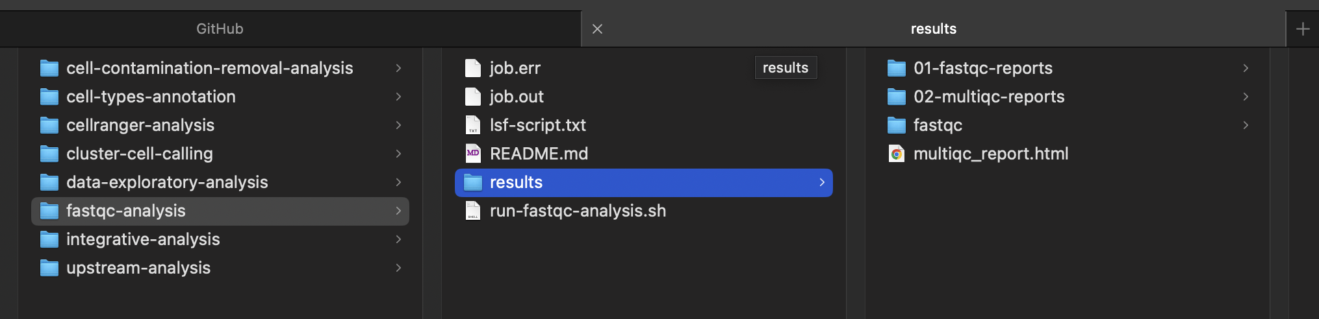
`fastqc-analysis` module
description="Pipeline for FastQC quality control tool for high throughput sequence data analysis.", required=True

Slide 29
`fastqc-analysis` module
description="Pipeline for FastQC quality control tool for high throughput sequence data analysis.", required=True

Slide 30
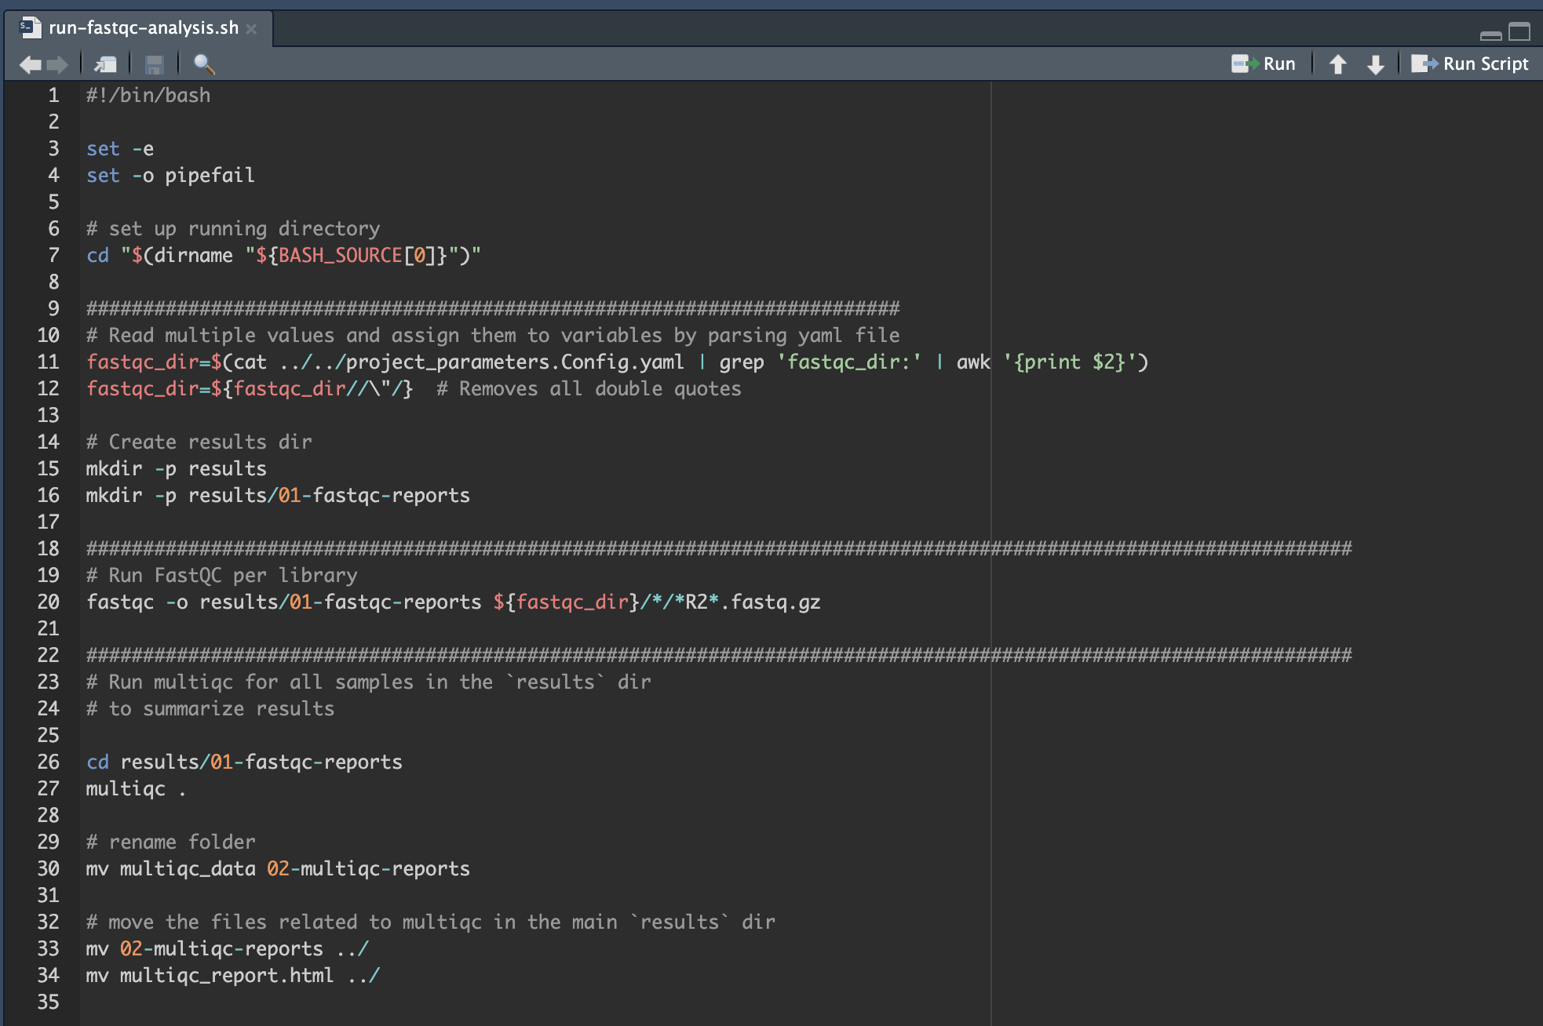
`run-fastqc-analysis.sh`

Slide 31
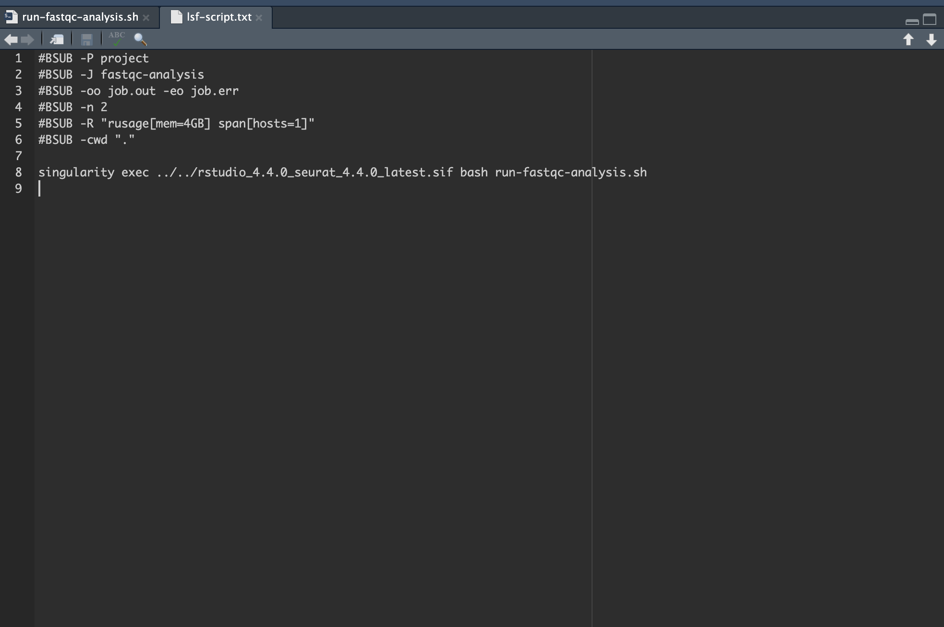
`run-fastqc-analysis.sh` and `lsf-script.txt`

Slide 32
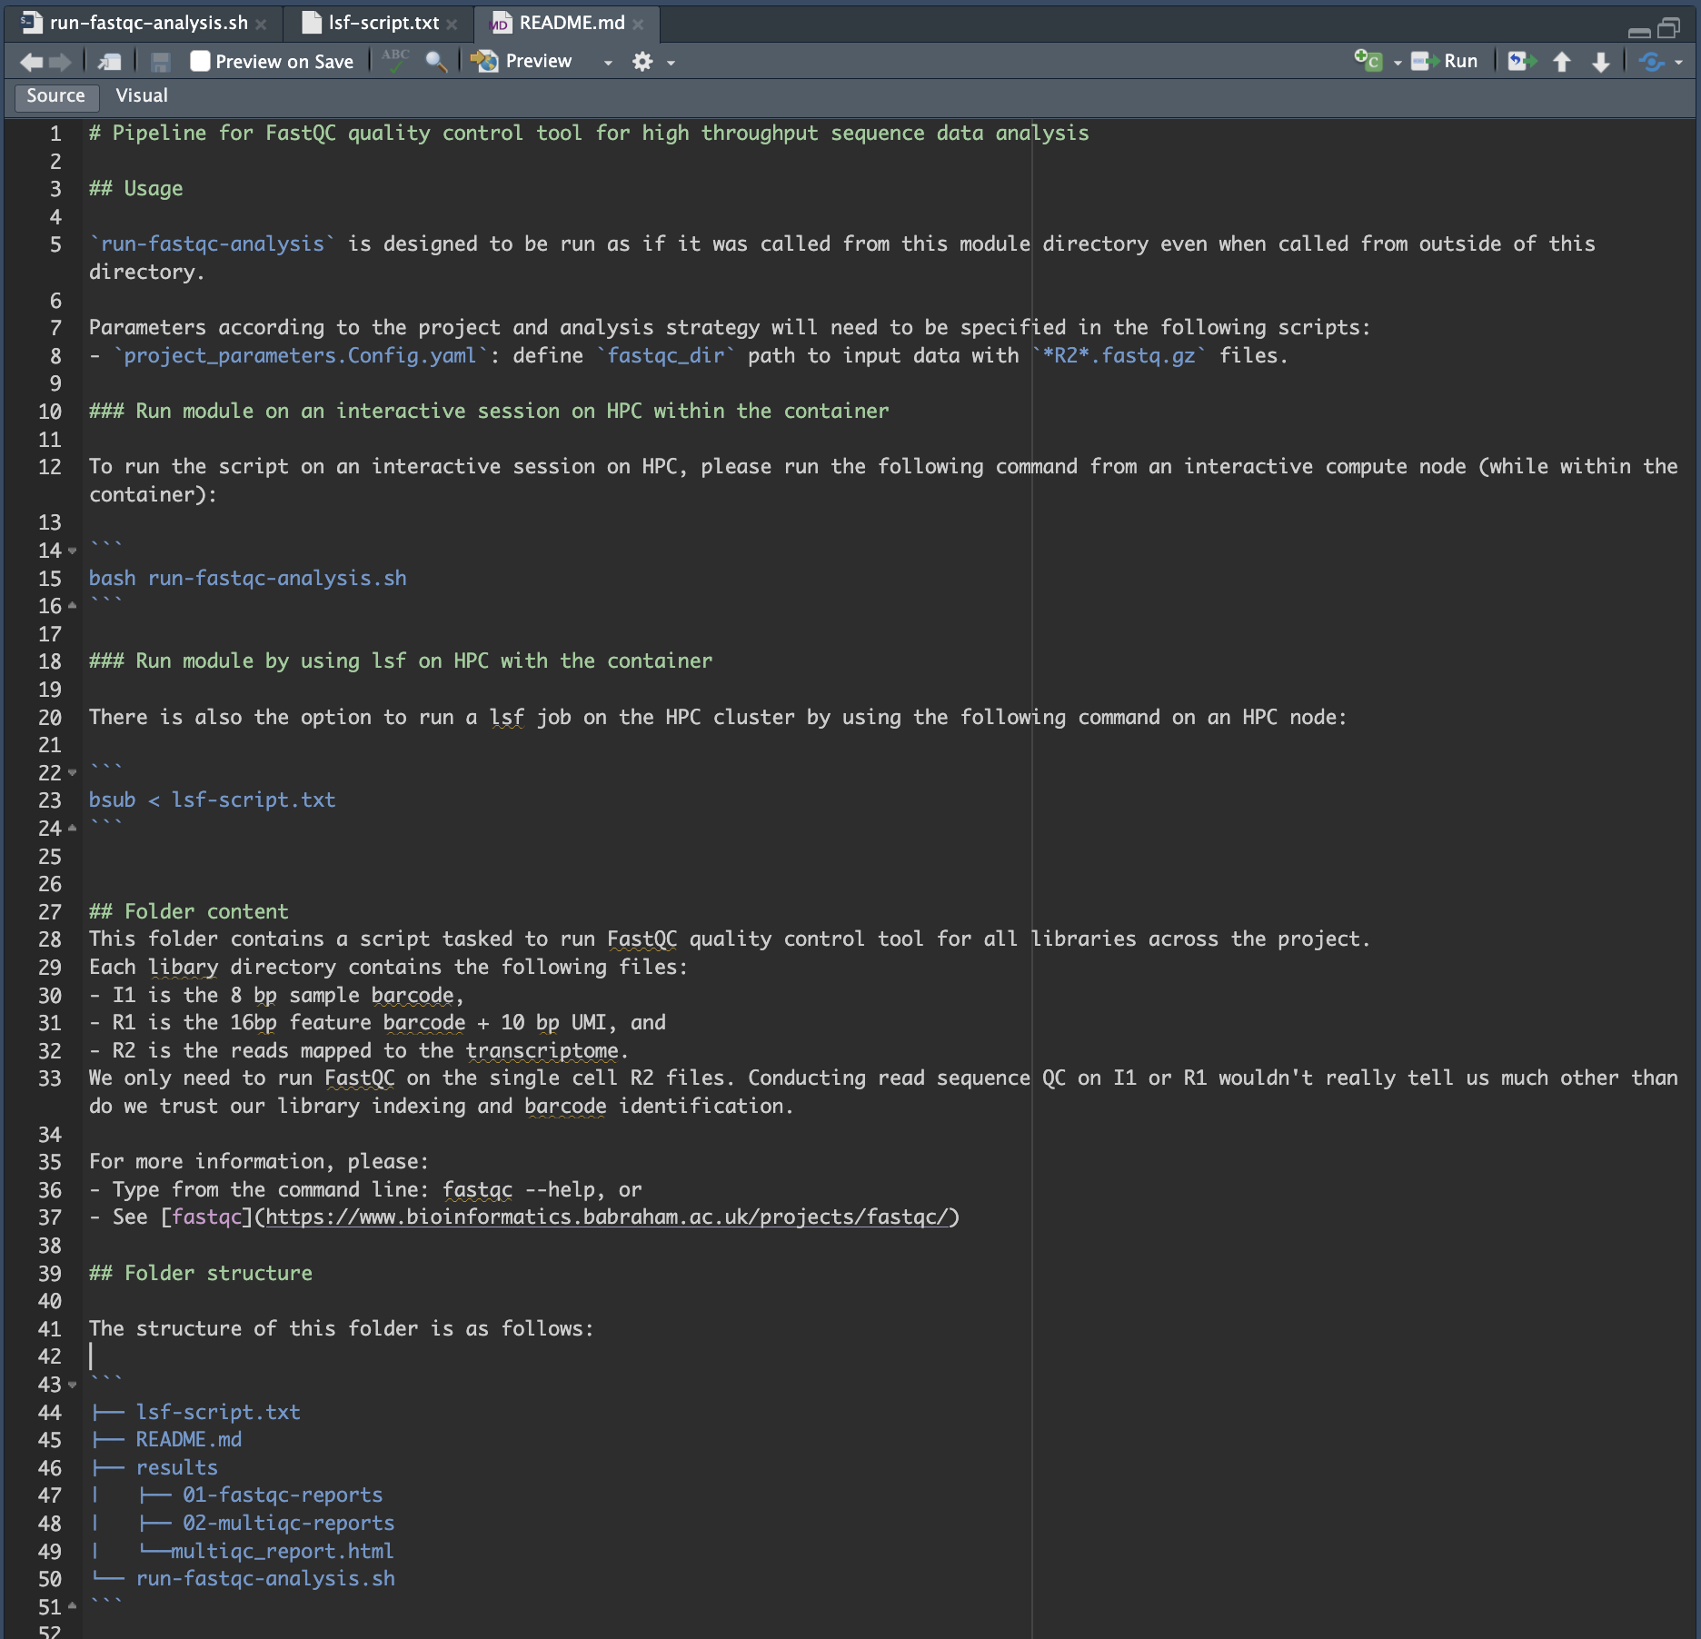
README.md

Slide 33

`fastqc-analysis` module
FASTQC and MultiQC methods
Notes:
MultiQC uses the output of FASTQC to aggregate the FastQC quality indicators of the different reads together, to allo inter-readset comparisons.

Slide 34
`fastqc-analysis` module
FastQC
multiqc

Slide 35



`fastqc-analysis` module
FastQC
multiqc

Slide 36
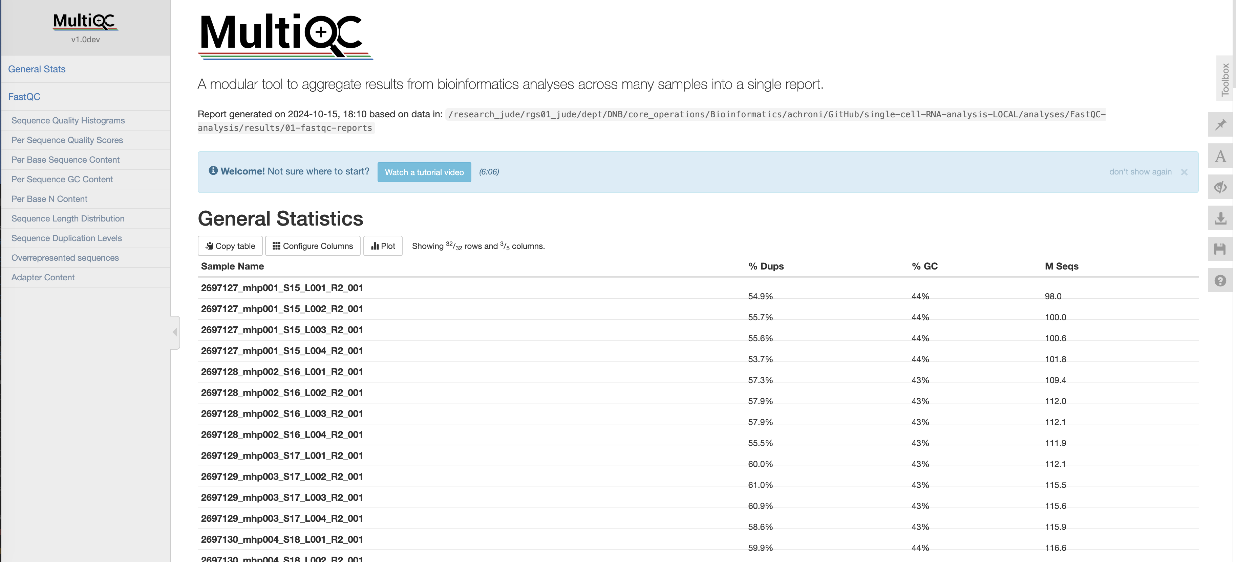
`fastqc-analysis` module

Slide 37
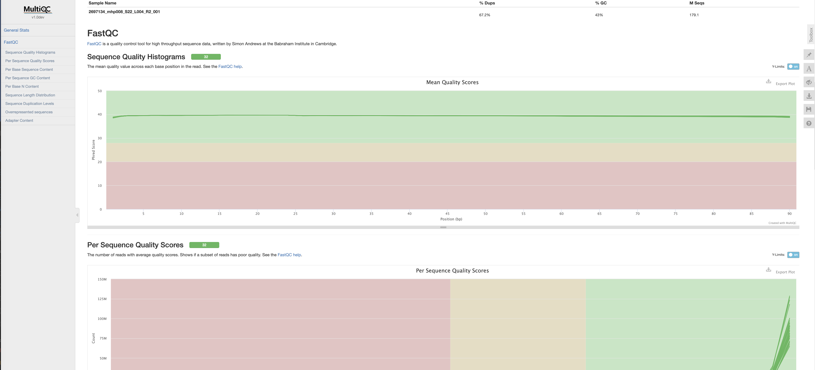
`fastqc-analysis` module

Slide 38
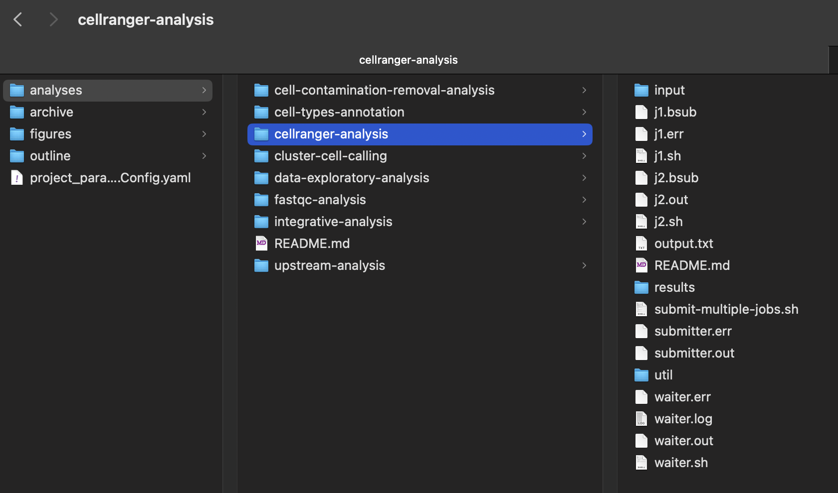
`cellranger-analysis` module
description="Pipeline for running and summarizing Cell Ranger count for single or multiple libraries.", required=True

Slide 39
`cellranger-analysis` module
description="Pipeline for running and summarizing Cell Ranger count for single or multiple libraries.", required=True

Slide 40
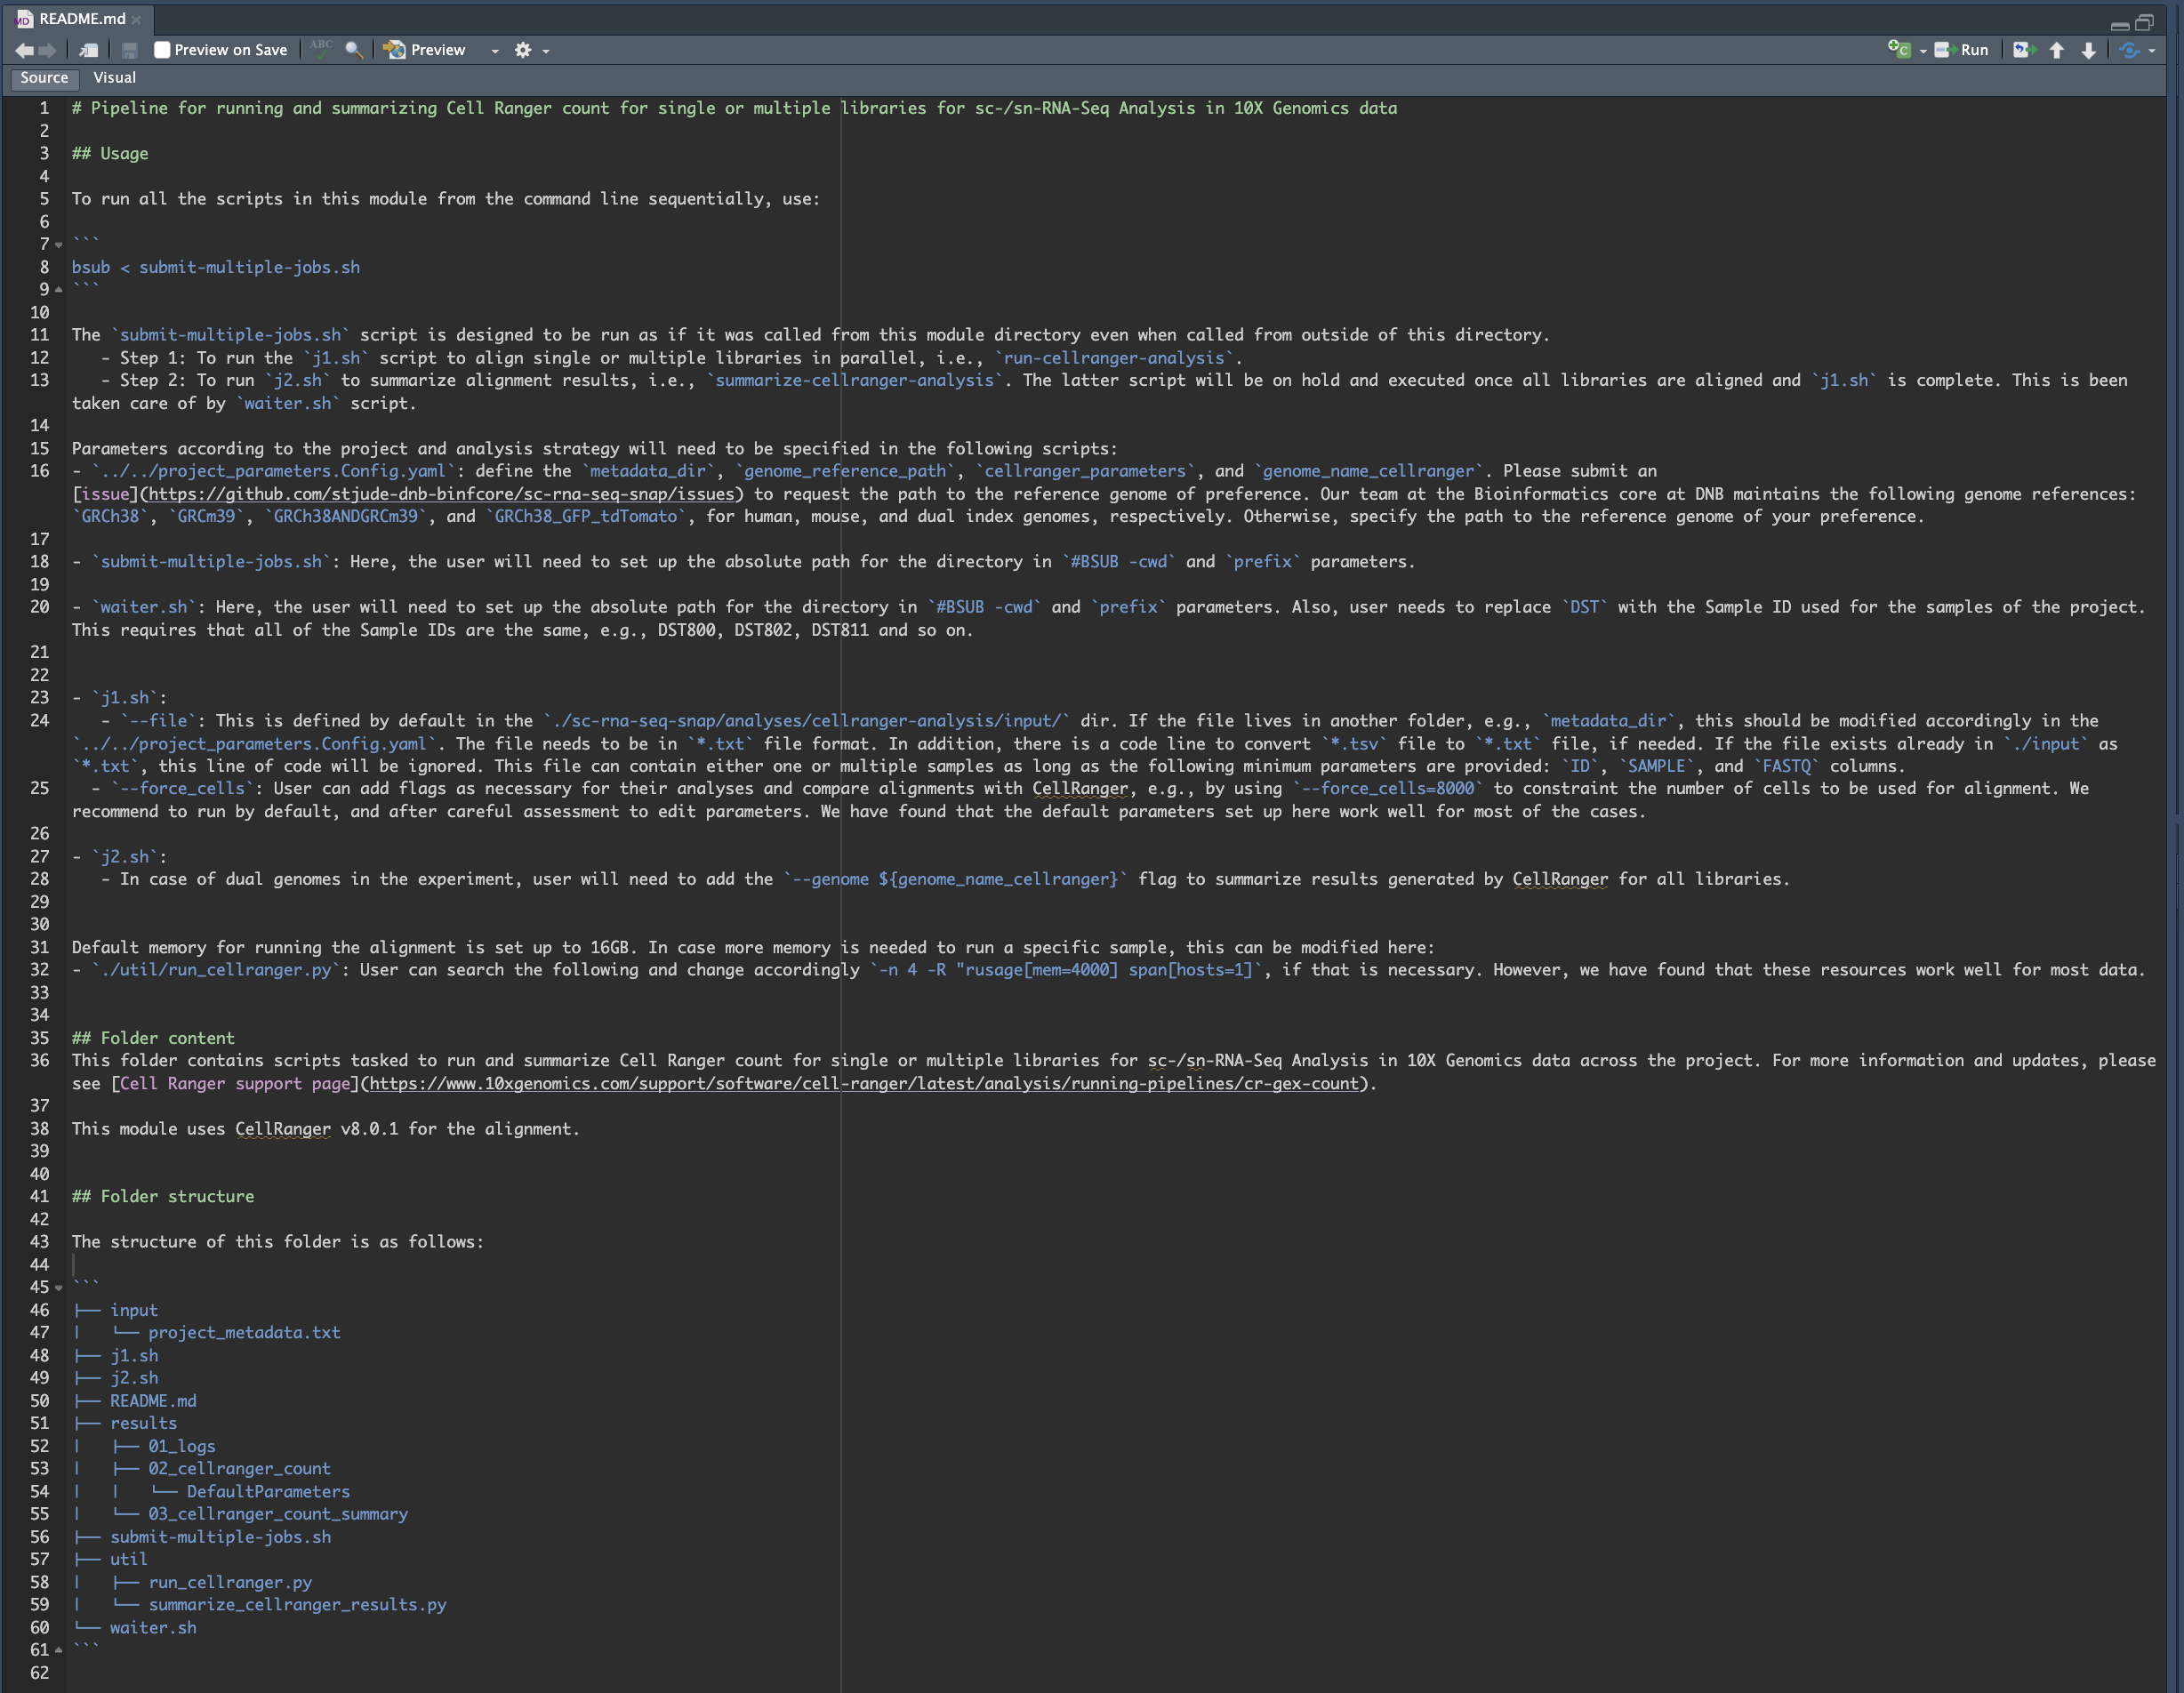
`cellranger-analysis` module

Slide 41
`cellranger-analysis` module

Slide 42
`cellranger-analysis` module

Slide 43
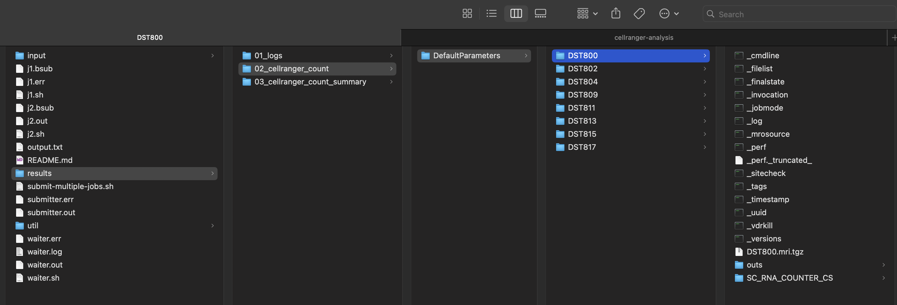
`cellranger-analysis` module

Slide 44
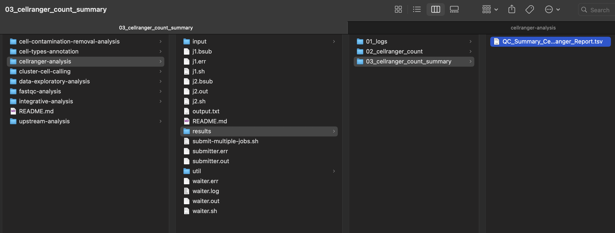
`cellranger-analysis` module

Slide 45
`cellranger-analysis` module

Slide 46
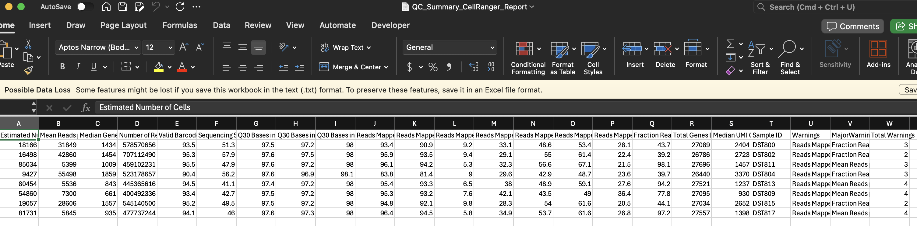
`cellranger-analysis` module

Slide 47
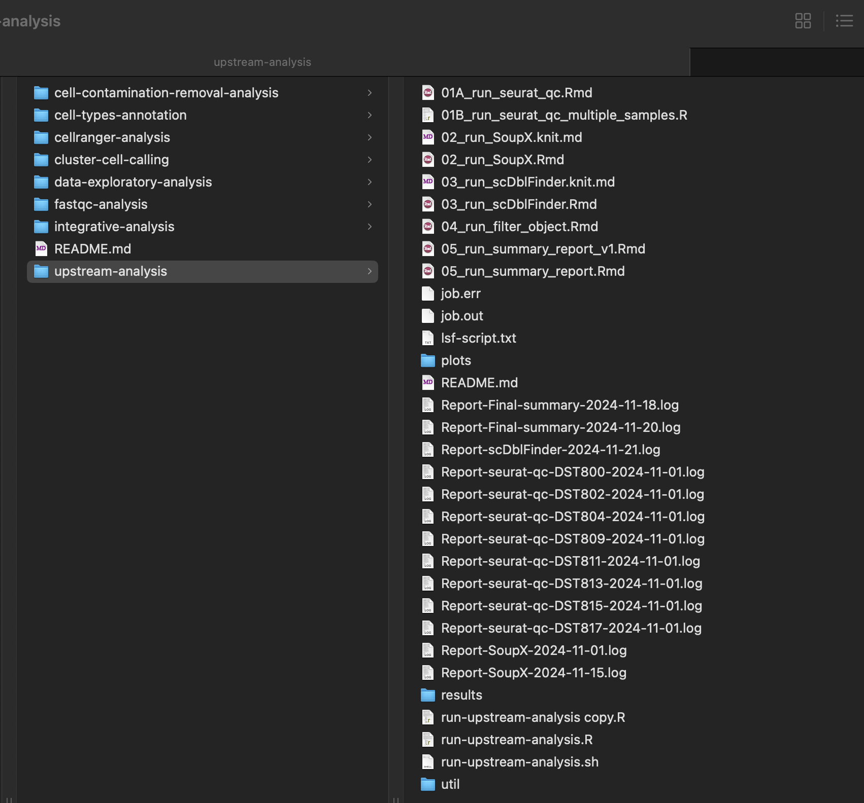
`upstream-analysis` module
description="Pipeline for estimating QC metrics and filtering low quality cells.", required=True

Slide 48
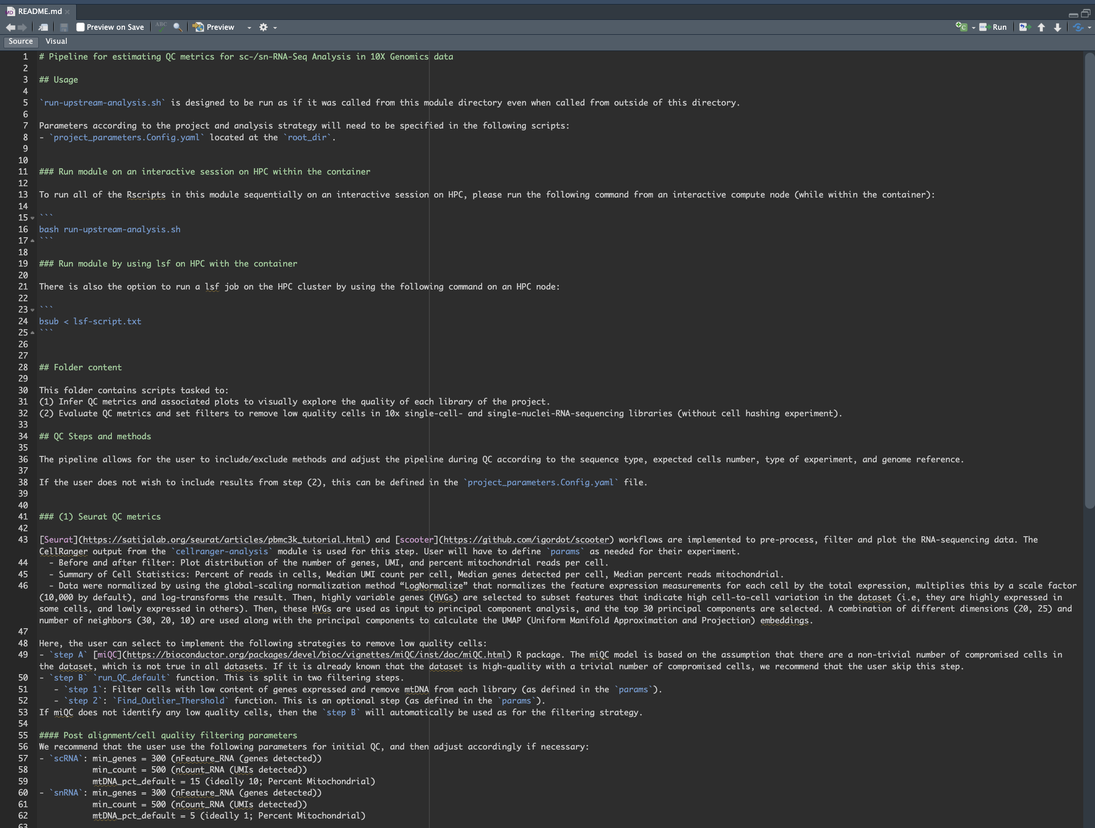
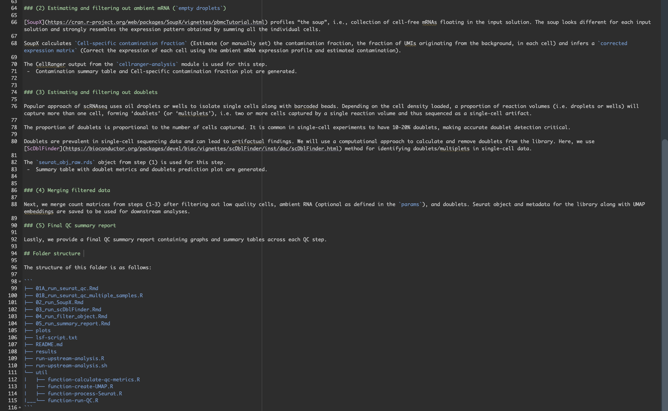
`upstream-analysis` module

Slide 49
`upstream-analysis` module
# | steps | aim
1 | seurat-qc pipeline | To infer QC metrics and remove low quality cells (miQC R package and/or `run_QC_default`)
2 | SoupX method | To estimate contamination fraction (ambient RNA) and adjust expression matrix
3 | scDblFinder method | To identify doublets/multiplets
4 | Merge and filter data | (steps 2 and 3 are optional during final filttering)
5 | Final QC summary report | To create clean object for downstream analysis

Slide 50
`upstream-analysis` module
# | steps | aim
1 | seurat-qc pipeline | To infer QC metrics and remove low quality cells (miQC R package and/or `run_QC_default`)
2 | SoupX method | To estimate contamination fraction (ambient RNA) and adjust expression matrix
3 | scDblFinder method | To identify doublets/multiplets
4 | Merge and filter data | (steps 2 and 3 are optional during final filttering)
5 | Final QC summary report | To create clean object for downstream analysis

Slide 51
`upstream-analysis` module
# | steps | aim
1 | seurat-qc pipeline | To infer QC metrics and remove low quality cells (miQC R package and/or `run_QC_default`)
2 | SoupX method | To estimate contamination fraction (ambient RNA) and adjust expression matrix
3 | scDblFinder method | To identify doublets/multiplets
4 | Merge and filter data | (steps 2 and 3 are optional during final filttering)
5 | Final QC summary report | To create clean object for downstream analysis

Slide 52
`upstream-analysis` module
# | steps | aim
1 | seurat-qc pipeline | To infer QC metrics and remove low quality cells (miQC R package and/or `run_QC_default`)
2 | SoupX method | To estimate contamination fraction (ambient RNA) and adjust expression matrix
3 | scDblFinder method | To identify doublets/multiplets
4 | Merge and filter data | (steps 2 and 3 are optional during final filttering)
5 | Final QC summary report | To create clean object for downstream analysis

Slide 53
`upstream-analysis` module
# | steps | aim
1 | seurat-qc pipeline | To infer QC metrics and remove low quality cells (miQC R package and/or `run_QC_default`)
2 | SoupX method | To estimate contamination fraction (ambient RNA) and adjust expression matrix
3 | scDblFinder method | To identify doublets/multiplets
4 | Merge and filter data | (steps 2 and 3 are optional during final filttering)
5 | Final QC summary report | To create clean object for downstream analysis

Slide 54

* Upstream analyses modules

Slide 55
ScRNASeqSnap analysis modules
We recommend the following order in running analysis modules which is up to customization based on the user's needs.
`fastqc-analysis` module (help=`Required`. Pipeline for FastQC quality control tool for high throughput sequence data analysis.)
`cellranger-analysis` module (help=`Required`. Pipeline for running and summarizing Cell Ranger count for single or multiple libraries.)
`upstream-analysis` module (help=`Required`. Pipeline for estimating QC metrics and filtering low quality cells.)
`integrative-analysis` module (help=`Required`. Pipeline for Integrative analysis.)
`cluster-cell-calling` module (help=`Required`. Pipeline for cluster cell calling and gene marker analysis.)
`cell-contamination-removal-analysis` module (help=`Optional`. To remove clusters and repeat steps (4) and (5), e.g. for PDX experiments)
`cell-types-annotation` module (help=`Required`. Pipeline for annotating cell types.)
Upstream
Downstream

Slide 56
ScRNASeqSnap analysis modules
Downstream

Slide 57
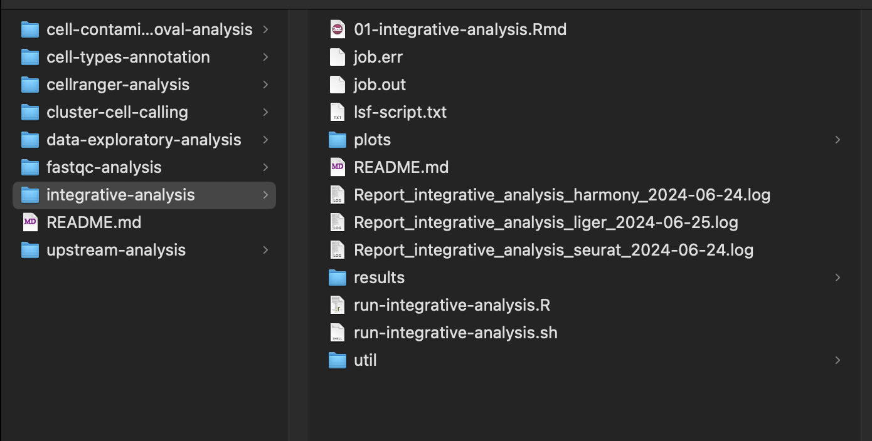
`integrative-analysis` module
description="Pipeline for Integrative analysis.", required=True

Slide 58
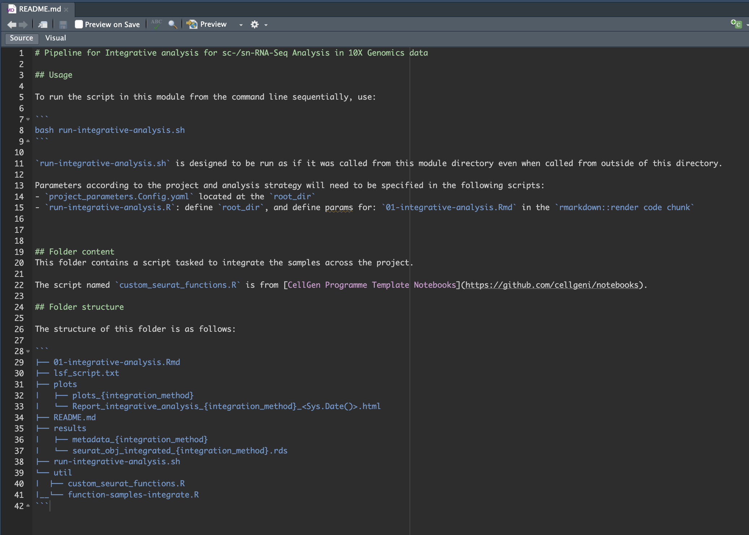
`integrative-analysis` module

Slide 59
`integrative-analysis` module
# | methods | aim
1 | seurat_integration | SCT method for the normalization and variance stabilization of molecular count data from scRNA-seq experiments
2 | harmony_integration | Harmony algorithm projects cells into a shared embedding in which cells group by cell type rather than dataset-specific conditions. Harmony simultaneously accounts for multiple experimental and biological factors
3 | liger_integration | LIGER algorithm enables the identification of shared cell types across individuals, species, and multiple modalities (gene expression, epigenetic or spatial data), as well as dataset-specific features, offering a unified analysis of heterogeneous single-cell datasets.

Slide 60
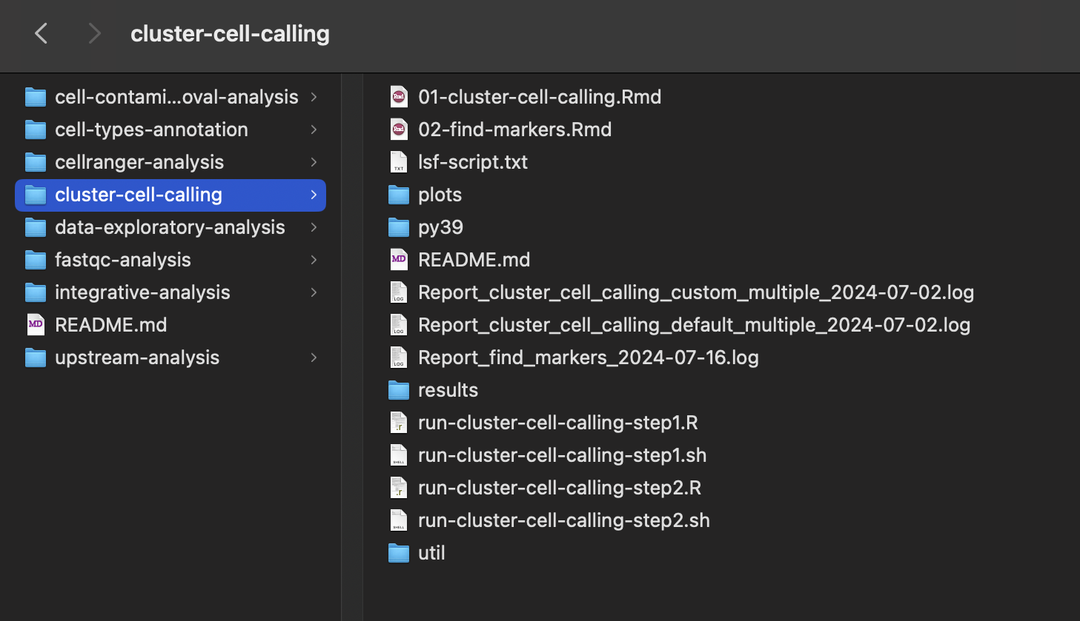
`cluster-cell-calling` module
description="Pipeline for cluster cell calling and gene marker analysis.", required=True

Slide 61
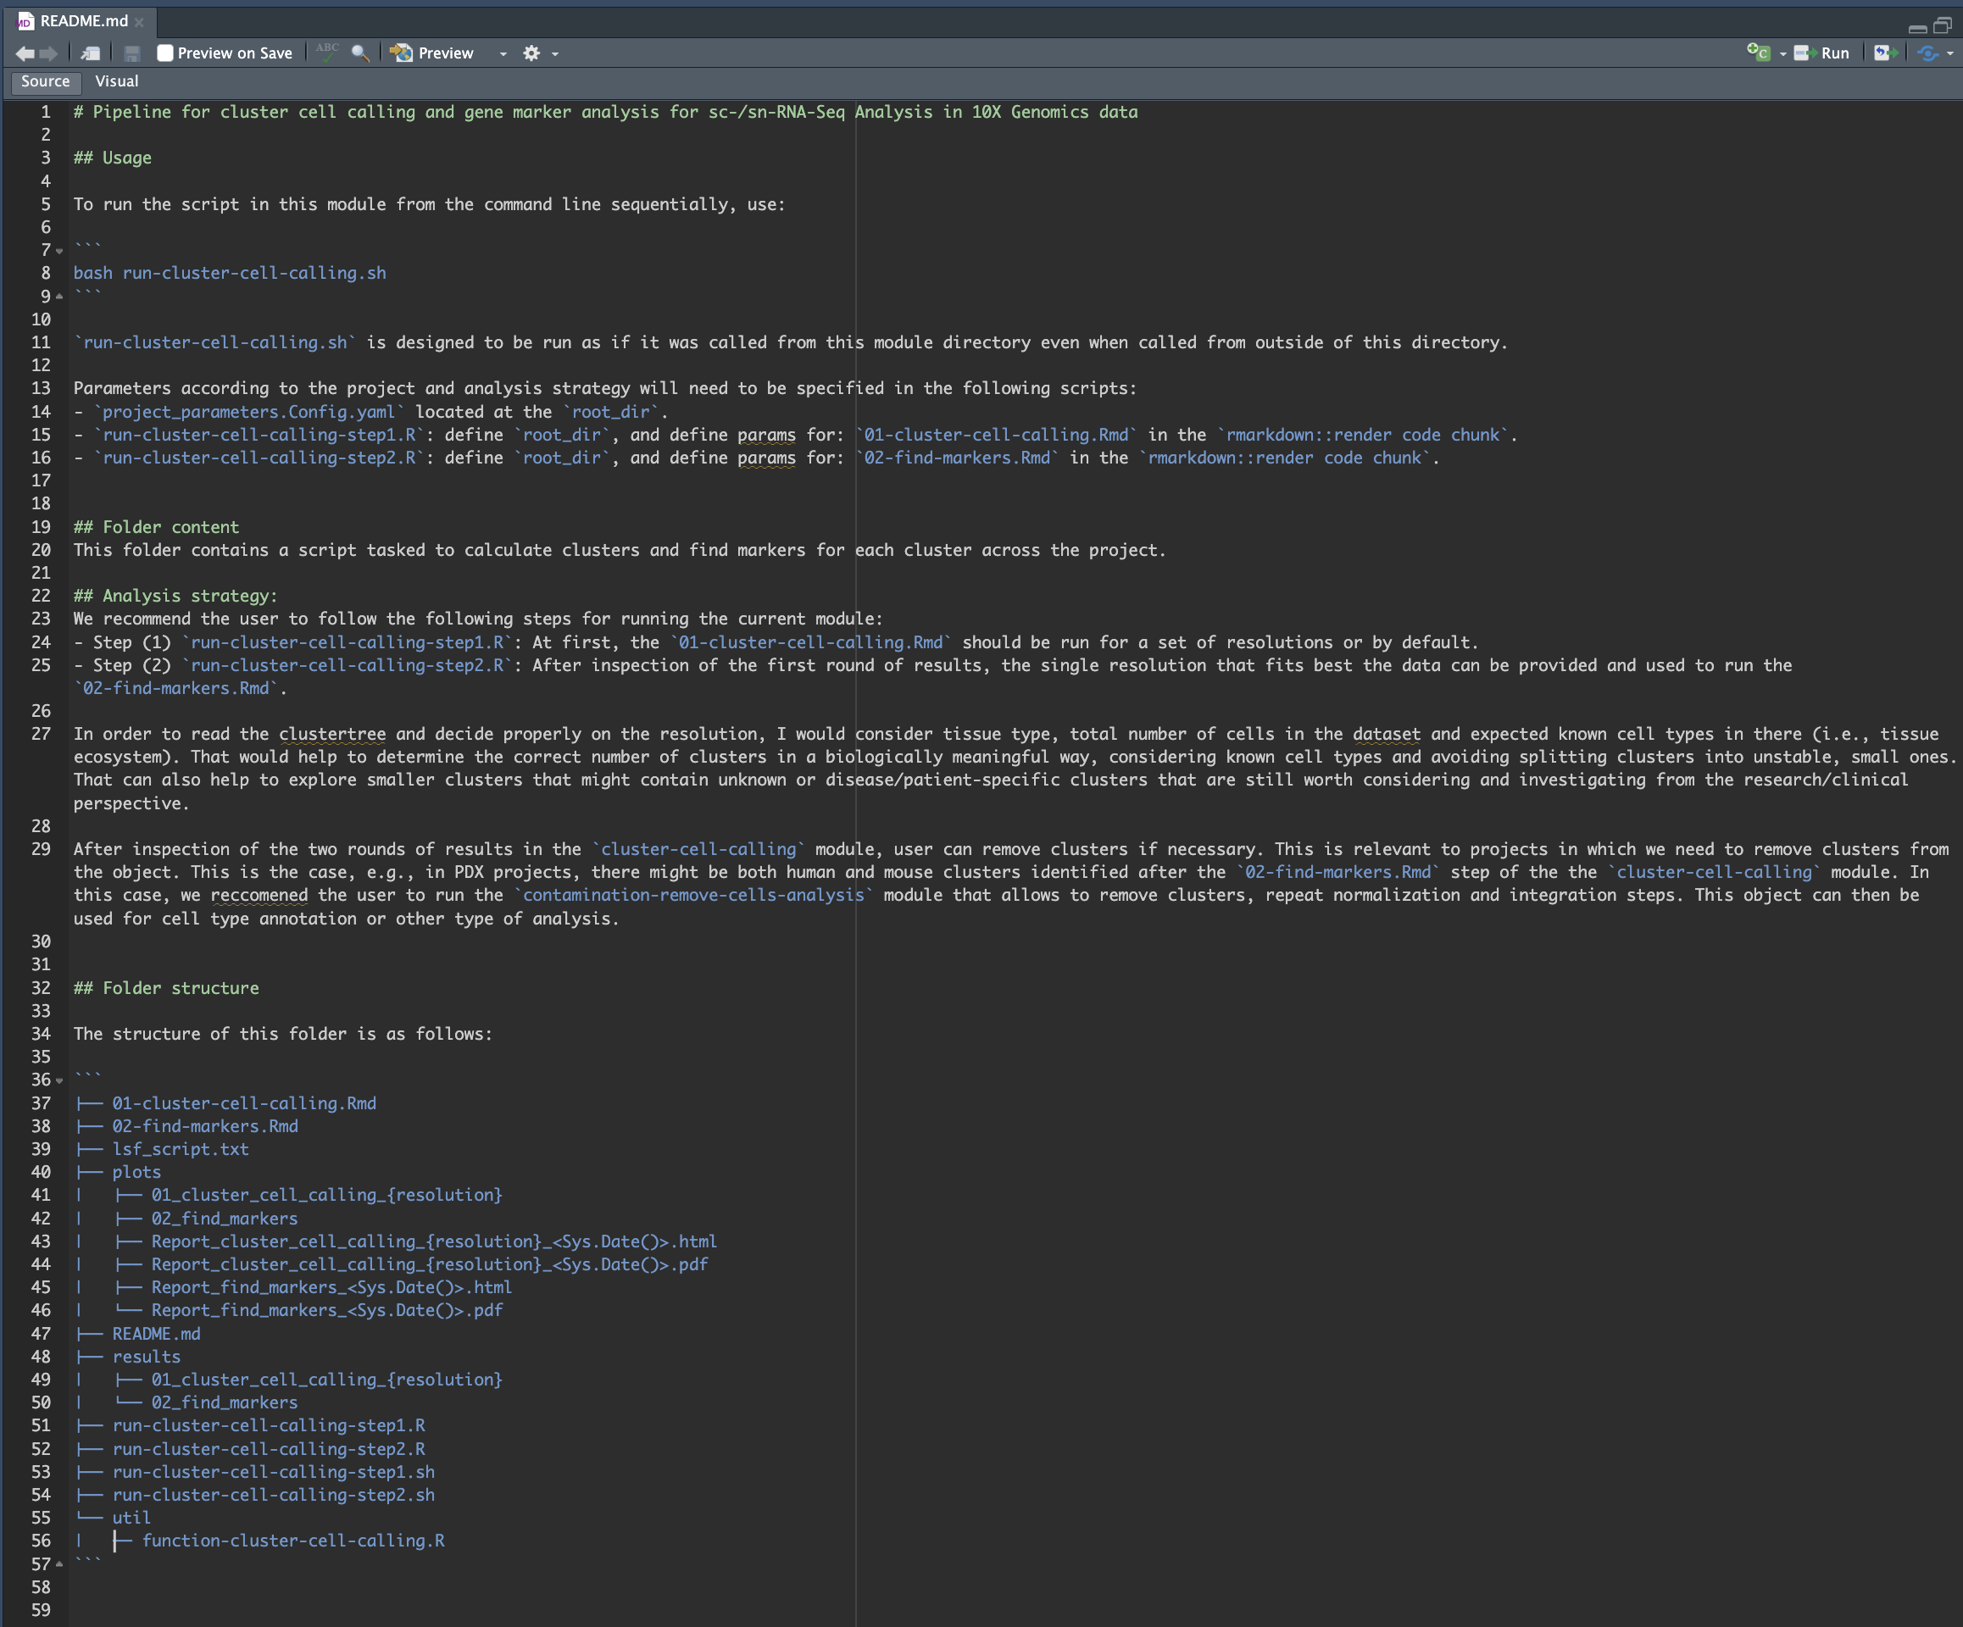
`cluster-cell-calling` module

Slide 62
`cluster-cell-calling` module
# | steps | aim
1 | cluster-cell-calling | To cluster the cells under different resolutions to define granularity
2 | find-markers | To find differentially expressed features (cluster biomarkers)

Slide 63
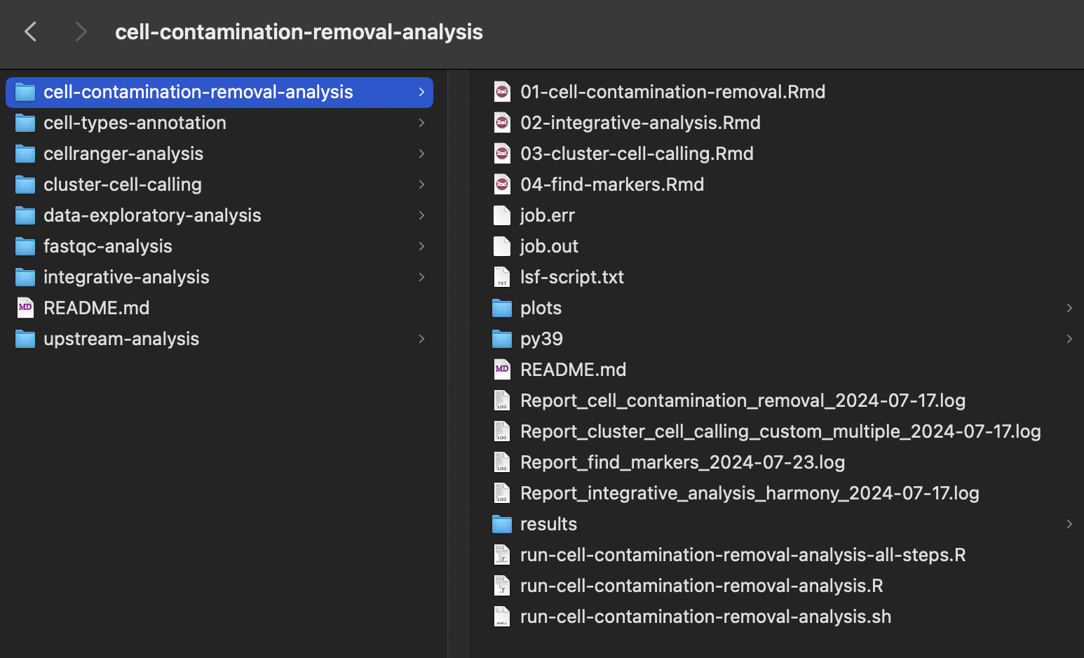
`cell-contamination-removal-analysis` module - optional
description="To remove clusters and repeat steps (4) and (5), e.g. for PDX experiments.", required=False

Slide 64
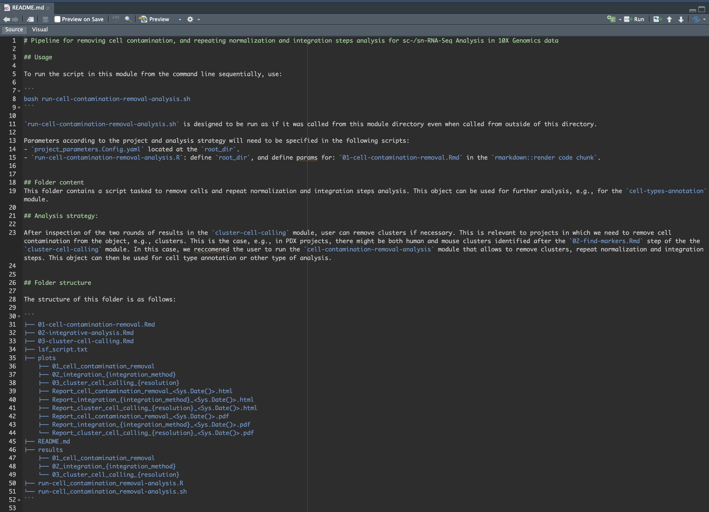
`cell-contamination-removal-analysis` module - optional

Slide 65
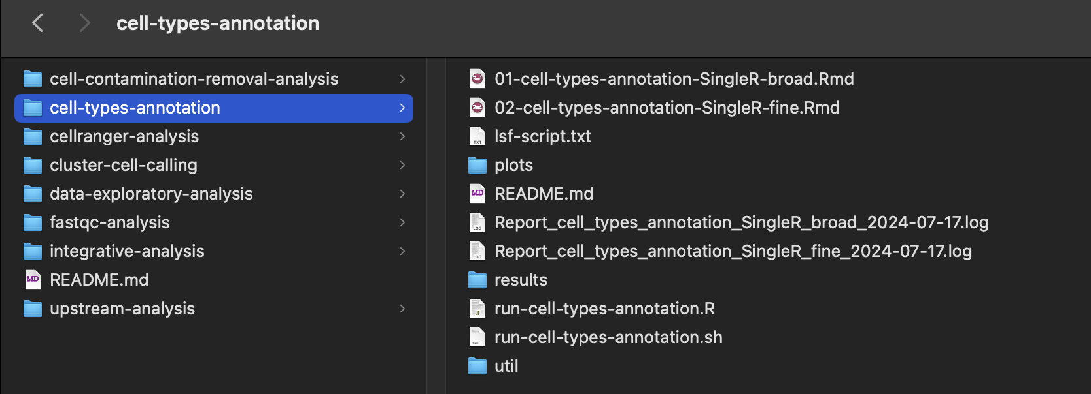
`cell-types-annotation` module
description="Pipeline for annotating cell types.", required=True

Slide 66
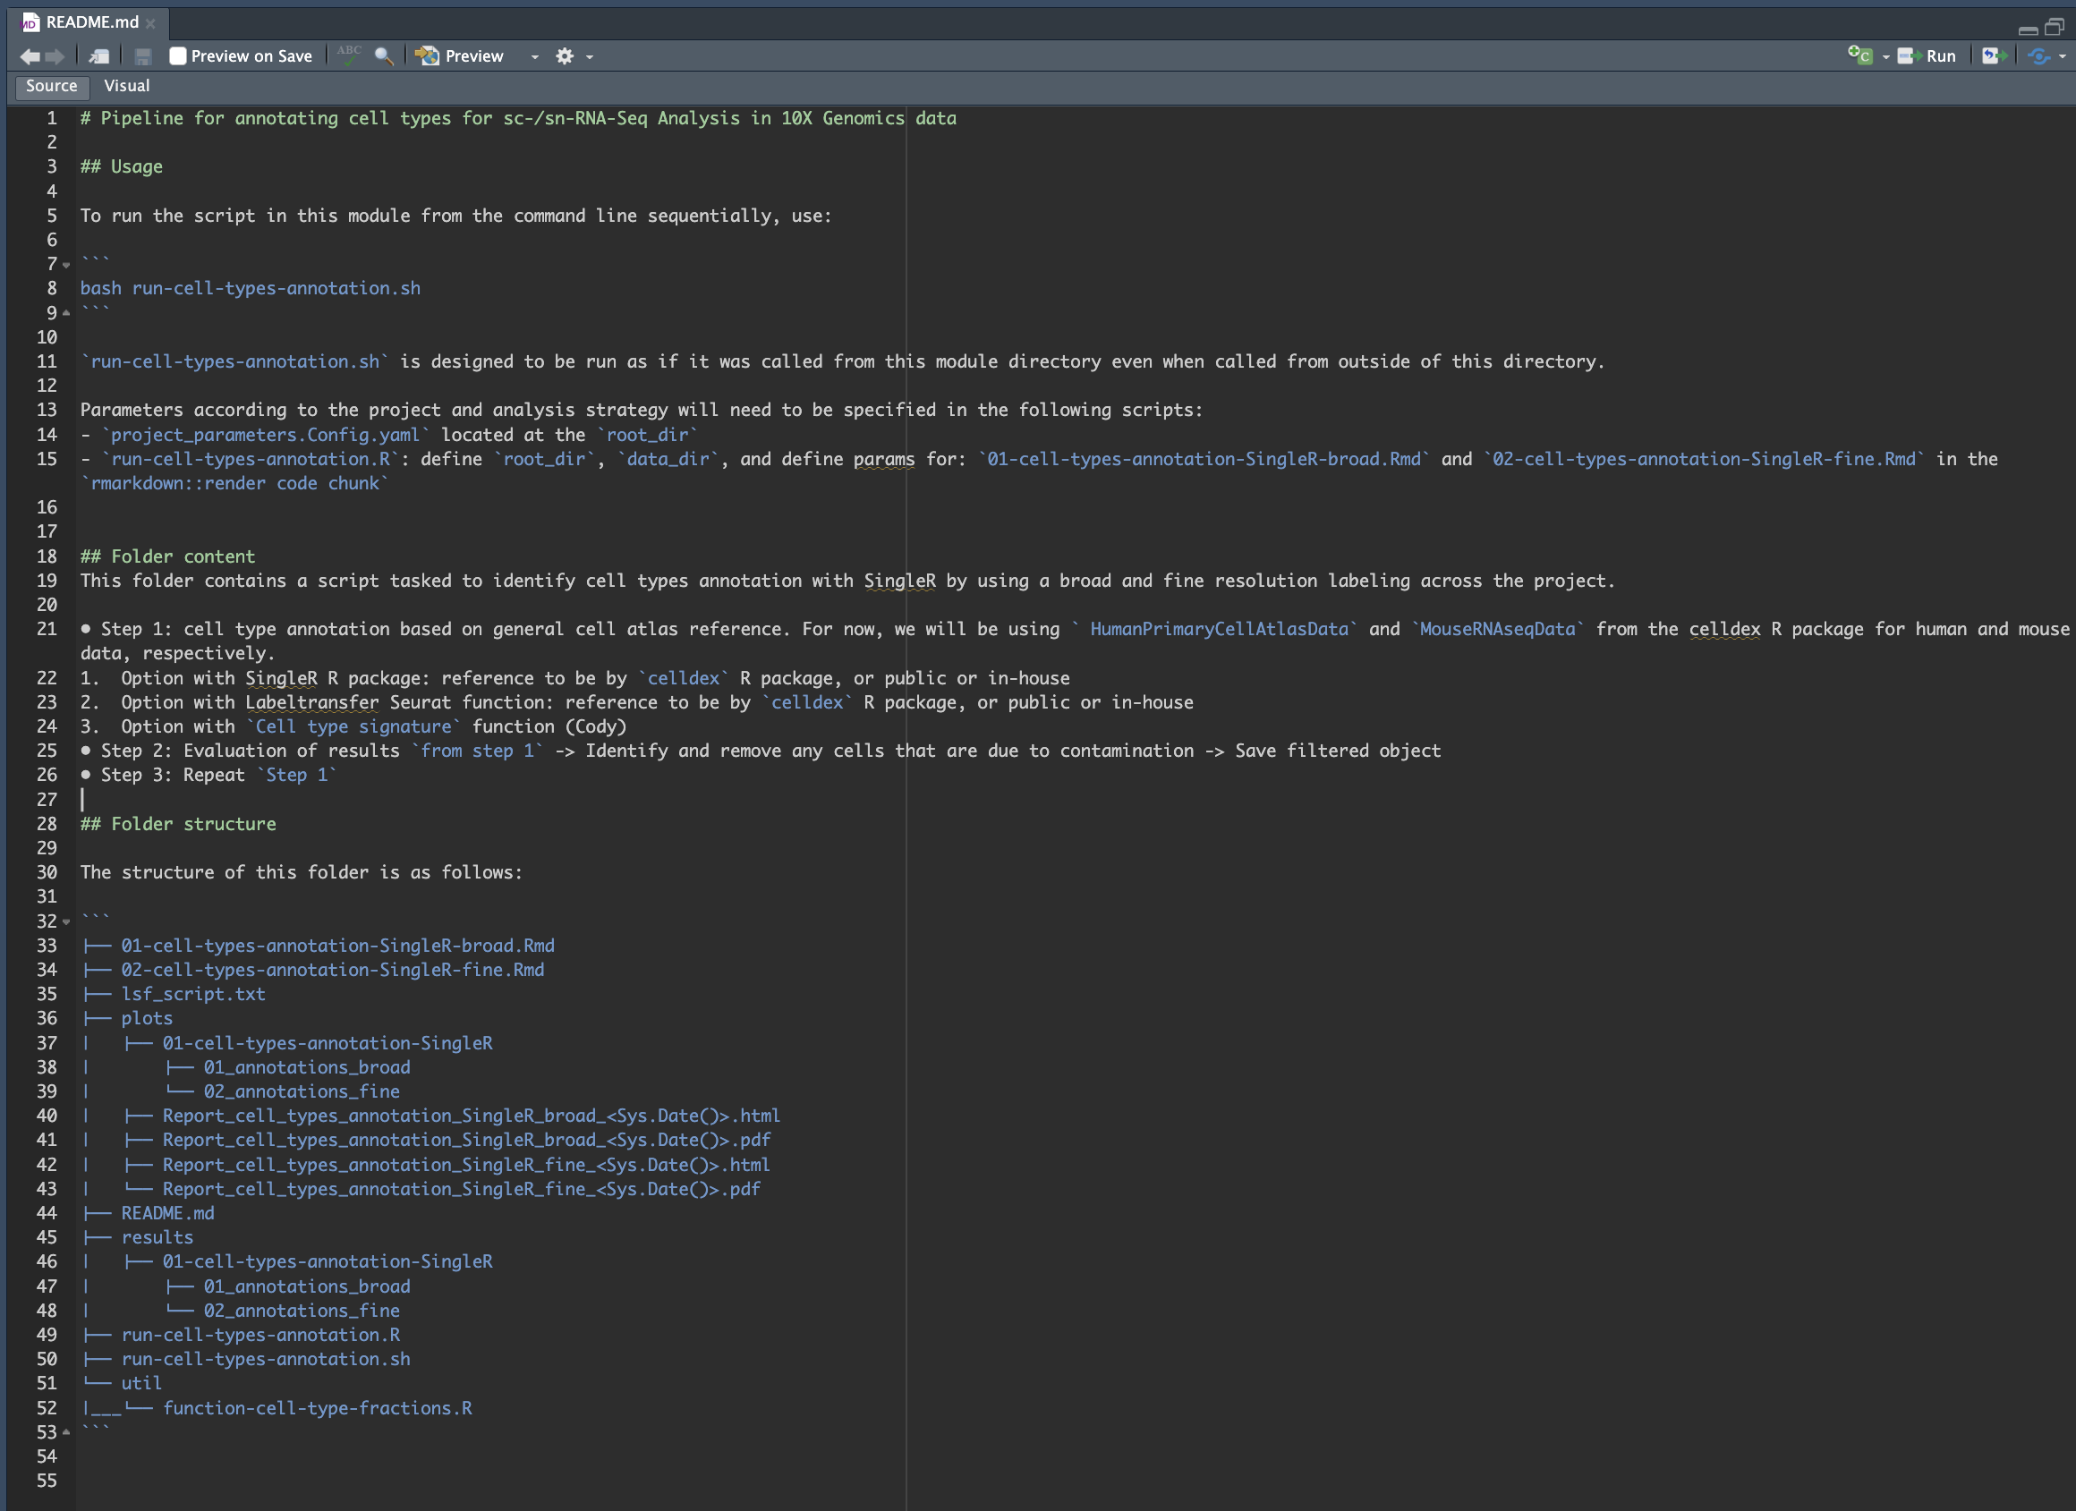
`cell-types-annotation` module

Slide 67
`cell-types-annotation` module
# | steps | aim
1 | cell-types-annotation-SingleR-broad | To identify cell types by using SingleR and celldex database and run diagnostics
2 | cell-types-annotation-SingleR-fine | To identify cell types by using SingleR and celldex database and run diagnostics

Slide 68
Next steps
🎉 Testing phase: code review process
🐛 Validation phase: Use another one (or more) datasets for validation purposes and fixing bugs
🚀 Launching!

Slide 69
Future analysis modules
`clone-phylogeny-analysis` module
`infer-tumor-microenvironment-analysis` module
`differential-expression-analysis` module
`trajectories-pseudotime-analysis` module
`rna-velocity-analysis` module
`cell-types-annotation` module: using custom atlas reference or gene signature score
R shiny app

Slide 70
More resources 🎉
Automation and Reproducibility in Computational Biology
Documentation and Usability
GitHub Docs
Docker for beginners
Docker for Data Scientists
./resources/links-to-resources.md

Slide 71


Slide 72
* Downstream analyses modules

Slide 73
Notes:
Walk them through the main folder
upstream-analysis: plots/01_Seurat_qc/DST800
upstream-analysis: plots/04_Filter_object
upstream-analysis: plots/05_Final_summary_report
integrative-analysis: plots/Report_integrative_analysis_harmony_2024-06-24.html
cell-types-annotation: plots/01_cell_types_annotation_SingleR/Report_cell_types_annotation_SingleR_broad_2024-07-17.html

Slide 74
Ask me questions 😀
..
Tonia
Antonia Chroni, PhD
she/her/hers
Senior Bioinformatics Research Scientist
New York, New York
@AntoniaChroni

